Slide 1
Metrology

Slide 2
Metrology
Metrology
  Instrumentation and Its
  Limits
  Science of physical measurement applied to
  variables such as dimensions

Slide 3
Outline
Measurement using balances
Precision versus Accuracy
Calibration of balances
Validation of pipetmen

Slide 4
Types of Balances
Labs are equipped with two types of balances:
Analytical balance
Top loading balance
The primary difference between these instruments is Significant Figures

Slide 5
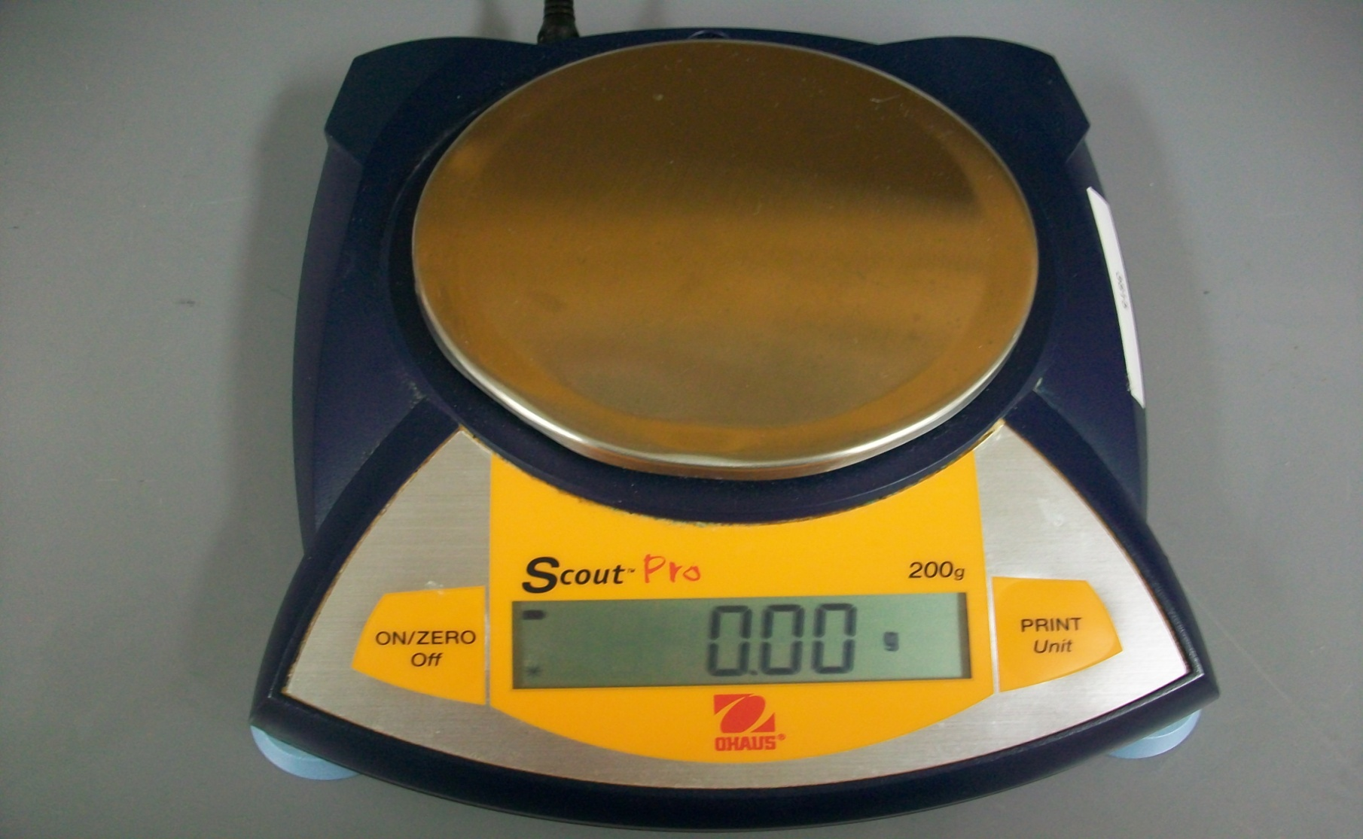
Precision = +/- 0.01g

Slide 6
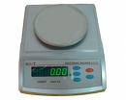
Top Loading Balance
Used when less quantitative results are required (+/- 0.01g) (Capacity < 1200 g)‏

Slide 7
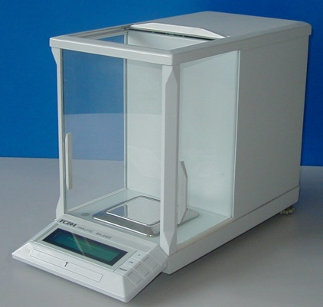
Analytical Balance
Used for measurements requiring highly quantitative results i.e. +/- 0.0002 g
(Capacity < 100 g)‏

Slide 8
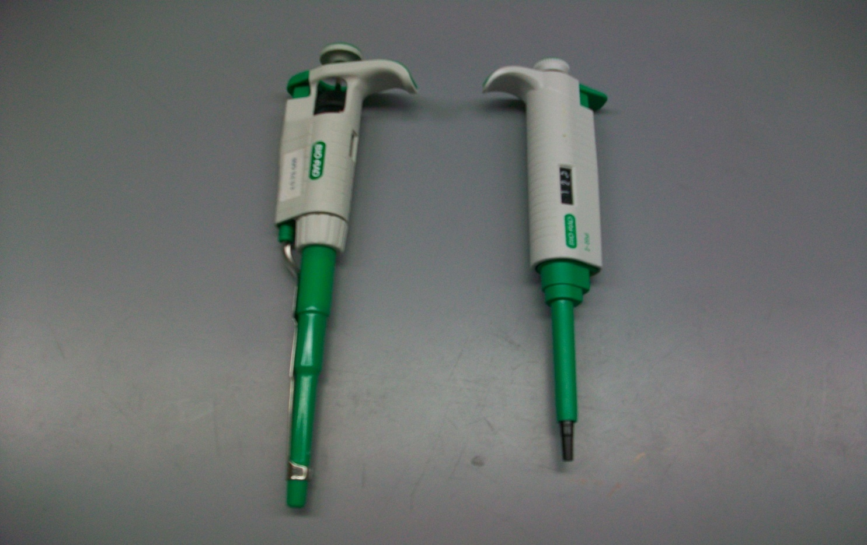
Bio-Rad Pipetmen
Pipets can measure +/-1% of their largest volume and be accurate

Slide 9
Limits of Measurement
All measurements contain some error and it is calculated by the following formula:
Percent Error =
True Value - Average Measured Value X 100%
True Value
All

Slide 10
Standard Deviation Gives a Measure of Variability
Σ (x - x)²
S =
n - 1

Slide 11
What are Significant Figures?
The necessary number of figures (digits) required to express the result of a measurement or calculation so that only the last digit in the number is in doubt.
Measuring gives significance (or meaning) to each digit in the number produced.

Slide 12
Why Consider Significant Figures?
Science depends upon experimentation which requires numerical measurements.
Measurements are taken from instruments made by other human beings.
NO measurement is exact
Error is always a factor

Slide 13
Determining Significant Figures
Last figure is estimated in measuring 2.33
All whole #'s are significant 2.33 = 3 sig figs
All zeros between 2 numbers are significant 2.03 = 3 sig figs
Zeros to the right of whole number digits are significant if prec by a decimal point
203.00 = 5 sig figs
All zeros to the right of a decimal point & whole number are significant 2.0230 = 5 sig figs
Zeros to the right of a decimal but to the left of a whole number are not significant 0.0203 3 sig figs

Slide 14
Accuracy
The accuracy of an analytical measurement is how close a result comes to the true value. The analytical method is calibrated using a known standard to determine the accuracy of a measurement.

Slide 15
Precision
- The reproducibility of multiple
measurements.
- It is evaluated statistically using standard
deviation, standard error, or confidence
interval.

Slide 16
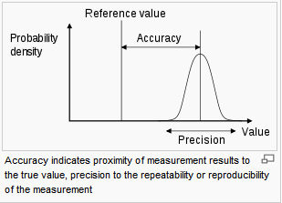
Measurement Requires Accuracy and Precision
Average value of X

Slide 17
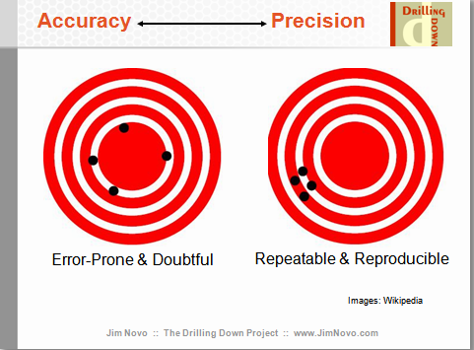
Accuracy vs Precision

Slide 18
Calibration of Balances
Balance is reset to detect a specific weight according to directions
A 200.00 g standard is placed on the balance
After recalibrating, the balance will then show a value equal to the standard

Slide 19
Validation of Pipetmen
Pipetman is selected and set to a specific volume : 1000 μl or 200 μl
Water is drawn up to a desired volume and place into weighed small beaker
Using the equation:
Density= Mass/Volume
*calculate the volume using 1 gram/ml for density of water

Slide 20
Percent Error
The deviation from an expected value can be expressed as a Percent Error
To calculate the Percent Error use the formula below:
% Error = True Value – Average value x 100
True Value

Slide 21
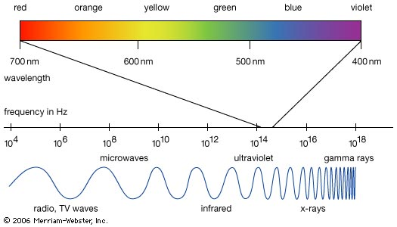
Electromagnetic Spectrum
The spectrum of electromagnetic waves ranges from low-frequency radio waves to high-frequency gamma rays. Only a small portion of the spectrum, representing wavelengths of roughly 400–700 nanometers, is visible to the human eye. © Merriam-Webster Inc.

Slide 22
Spectroscopy
When light of a specific wavelength interacts with a substance, the subsequent energy transfer results in:
    Absorption
    Fluorescence

Slide 23
Absorption
As the light hits a substance,
energy is transferred to the substance
thereby raising its energy to an excited
state.

Slide 24
Fluorescence
Molecular absorption of a photon triggers the emission of another photon with a longer wavelength when the molecule relaxes back to its ground state.
Excitation: S₀ + hv → S₁
Fluorescence: S₁ → S₀ + hv
h = Planck’s constant
v = frequency of light
S₀ = ground state of the fluorescent molecule
S₁ = excited state

Slide 25
Examples of Fluorescence
Molecules that are excited through light absorption can transfer energy to a second molecule, which is converted to its excited state and can then fluoresce.
Fluorescent lights
Light emitting diodes (LEDs)‏
Mercury vapor streetlight
Glow sticks
Compact fluorescent lighting (CFL)‏

Slide 26
UV/Vis Spectrophotometer
Principle:
Absorption of light in the visible and ultraviolet spectrum results in changes electronic structure of molecules

Slide 27
UV/Vis Spectrophotometer
Dual light source:
Visible range: Tungsten lamp (400 – 700 nm)‏
UV range: Deutrium lamp (200 – 400 nm)‏
Sample cells
Detector
Mirrors
Grating Monochrometer

Slide 28
Application
Lambert-Beer Law A = εcl where:
A = absorbance
ε = molar extinction coefficient (L mmol⁻¹ cm⁻¹)‏
c = molar concentration (mM)‏
l = pathlength (cm)‏
The Lambert-Beer law is used to accurately determine the concentration of a substance by measure absorbance at a specific wavelength

Slide 29
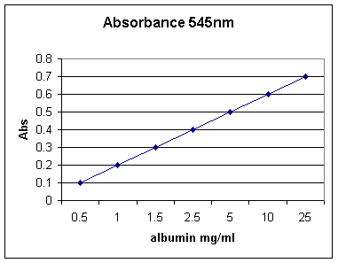
Determining Concentration
The Lambert-Beer Law is used to determine the concentration of an unknown using a standard curve.
Equation for a line
y = 0.063 x + 0.002 R² = 0.998

Slide 30
Determining Nucleic Acid Concentration
Quantitative measurements (µg) for nucleic acids (DNA and RNA) at A₂₆₀
A = εcl
  ε is specific for each type of nucleic acid
  1 OD₂₆₀ of ds-DNA = 50 µg/mL
  1 OD₂₆₀ of ss-DNA = 37 µg/mL
  1 OD₂₆₀ of ss-RNA = 40 µg/mL

Slide 31

Other Wavelengths
A₂₈₀: Protein
A₂₃₀: Phenol and peptide
A_{260/280}: Purity of nucleic acid preparation
(Pure range 1.8 – 2.0)‏

Slide 32
Terminology
Solution: A homogenous liquid mixture composed of two or more substances
Solute: Substance which dissolves in the solvent
(ex H₂0)‏
Solvent: Liquid in which solute is dissolved
Concentration: The ratio of the mass of a solute to the volume of solution Examples: g/mL, mol/L, %
Dilution (factor, medium, volume):
Serial dilution is logarithmic
Linear dilution using C₁V₁ – C₂ V₂

Slide 33
Terminology (cont.)‏
Aliquot: Equally divided portions of a sample
Buffer: A salt solution which resists change in pH upon addition of acid or base
Reagent: A substance which is involved in or consumed during a chemical reaction or to detect other substances
Meniscus: A curve in the surface of a liquid which results from interaction with the container

Slide 34
Common Buffers
Optimal pH ranges for common laboratory buffers

Slide 35
pH
pH = -log [H⁺]
pH 7: Neutral: [H+] = 10⁻⁷
pH > 7: Basic: [H+] > 10⁻⁷
pH < 7: Acidic: [H+] < 10⁻⁷
A pH meter is an instrument used to measure the pH of a liquid. Components include:
Probe (glass electrode)
Meter (measures and displays pH)‏

Slide 36
How pH is Measured
When two solutions with different pH values exist inside and outside a glass membrane, an electromotive force is proportional to the difference between the two pH values. The solution inside the glass membrane has a pH value of 7. The pH value of the solution outside the membrane can be obtained by measuring the electromotive force generated in the membrane.

Slide 37
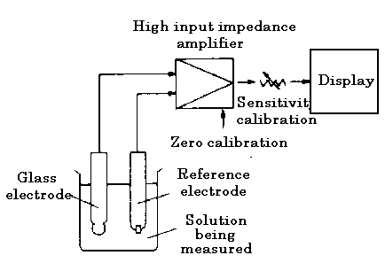
pH Meter
The pH meter consists of a glass electrode and a reference electrode. It allows the pH value of the sample to be obtained by measuring the potential difference between the two electrodes with a potential difference meter.
To calibrate the pH meter, a standard solution with a known pH value is used. As standard solutions, phthalic acid (pH 4.01), neutral phosphate (pH 6.86), and borate (pH 9.18) are mainly used.

Slide 38
Preparing solutions
Concentration is the ratio of the mass (or volume) of a solute to the mass (or volume) of the solution (or solvent)‏
  Mass/volume (%w/v)‏
  Volume/volume (%v/v)‏
  Molar volume (mol/L or M)‏

Slide 39
Sample Calculation
Ex. Prepare 1 L of 1.5 M Tris pH 7.5
Determine total number of moles of Tris required. 1 L X 1.5 mol/L = 1.5 mol
Tris (MW = 121.1 g/mol)‏
1.5 mol X 121.1 g/mol = 181.65 g Tris
3. Dissolve 181.65 g Tris in 700 mL dH₂0 (using beaker)‏
4. Adjust pH to 7.5
5. Transfer to 1 L graduated cylinder. Bring to final volume with dH₂0.

Slide 40
Material Safety Data Sheet (MSDS)‏
Detailed information on
  Physical and chemical hazards
  Handling procedures
  Emergency response procedures
There must be a MSDS for every chemical used and stored in a laboratory
MSDS for all chemicals must be read and understood before starting a procedure

Slide 41

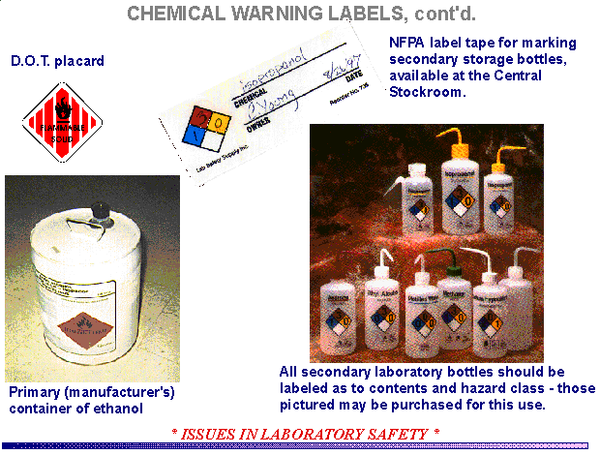
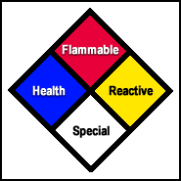
Labels
Your first line of defense are container labels
Chemical manufacturers post physical and health hazards on container labels
What information goes on a container label??
  Name
  Manufacturer’s information
  Physical hazards
  Storing, handling, and disposal
  Health hazards
  PPE

Slide 42
National Fire Protection Association - NFPA CODE
http://www.orcbs.msu.edu/chemical/nfpa/nfpa.html
Blue = Health
Red = Flammable
Yellow = Reactive
White = Special Hazard
Ex : ACID, NO WATER
Scale = 0 – 4
Least Intense to Most Intense

Slide 43
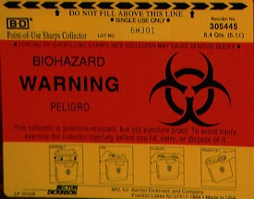
LABELING… Biohazards
What is a Biohazardous material?
  Biological in nature
  Capable of producing harmful effects
  on other biological organisms, particularly humans
  Examples:
  Certain bacteria, fungi, viruses, parasites, recombinant products, allergens, cultured human or animal cells and their potentially infectious agents

