Slide 1
Purification of Green Fluorescent Protein

Slide 2
Biomanufacturing Steps in Product Purification
UPSTREAM PROCESSING
Genetically engineered protein produced by an organism (ex. E.coli) are grown to yield the optimal amount of product
DOWNSTREAM PROCESSING
Cells which do not export product need to be, isolated, homogenized, and crude fractions obtained by centrifugation
Chromatography of partially purified product is then carried out

Slide 3
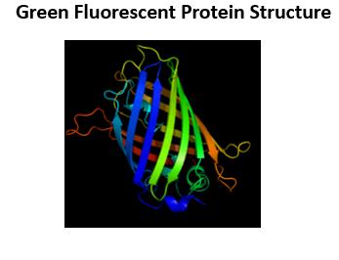
Green Fluorescent Protein
Why we use GFP production to exemplify Biomanufacturing Process
Useful in following the purification process by using UV light detection of GFP
In the presence of arabinose, GFP gene is transcribed into mRNA and translated into protein product

Slide 4
Flow Chart for GFP Product in Process
3. Step
Purification by
Chromatography
Production of GFP by Cell Growth and Division
Harvesting and Initial Purification
Chromatography and highly purified final product
Step 2
Crude separation of
product
Step 1
Growth of cells

Slide 5
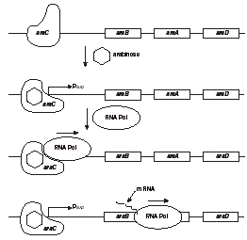
STEP 1 - Cell Growth of Transformed E.coli Results In GFP Product
Bio-rad.com

Slide 6
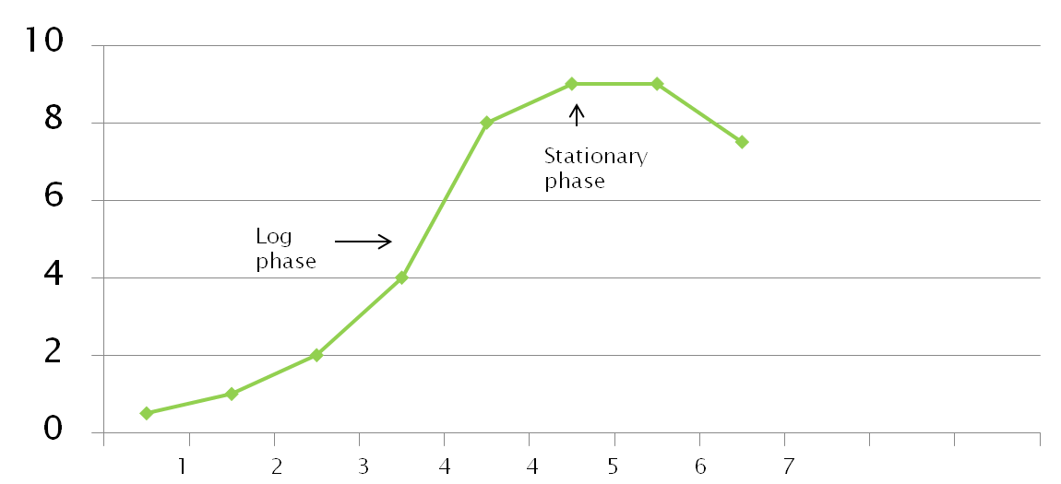
Growth of Transformed Cells in Culture
Number
of cells
time of E. coli growth in culture (hours)

Slide 7
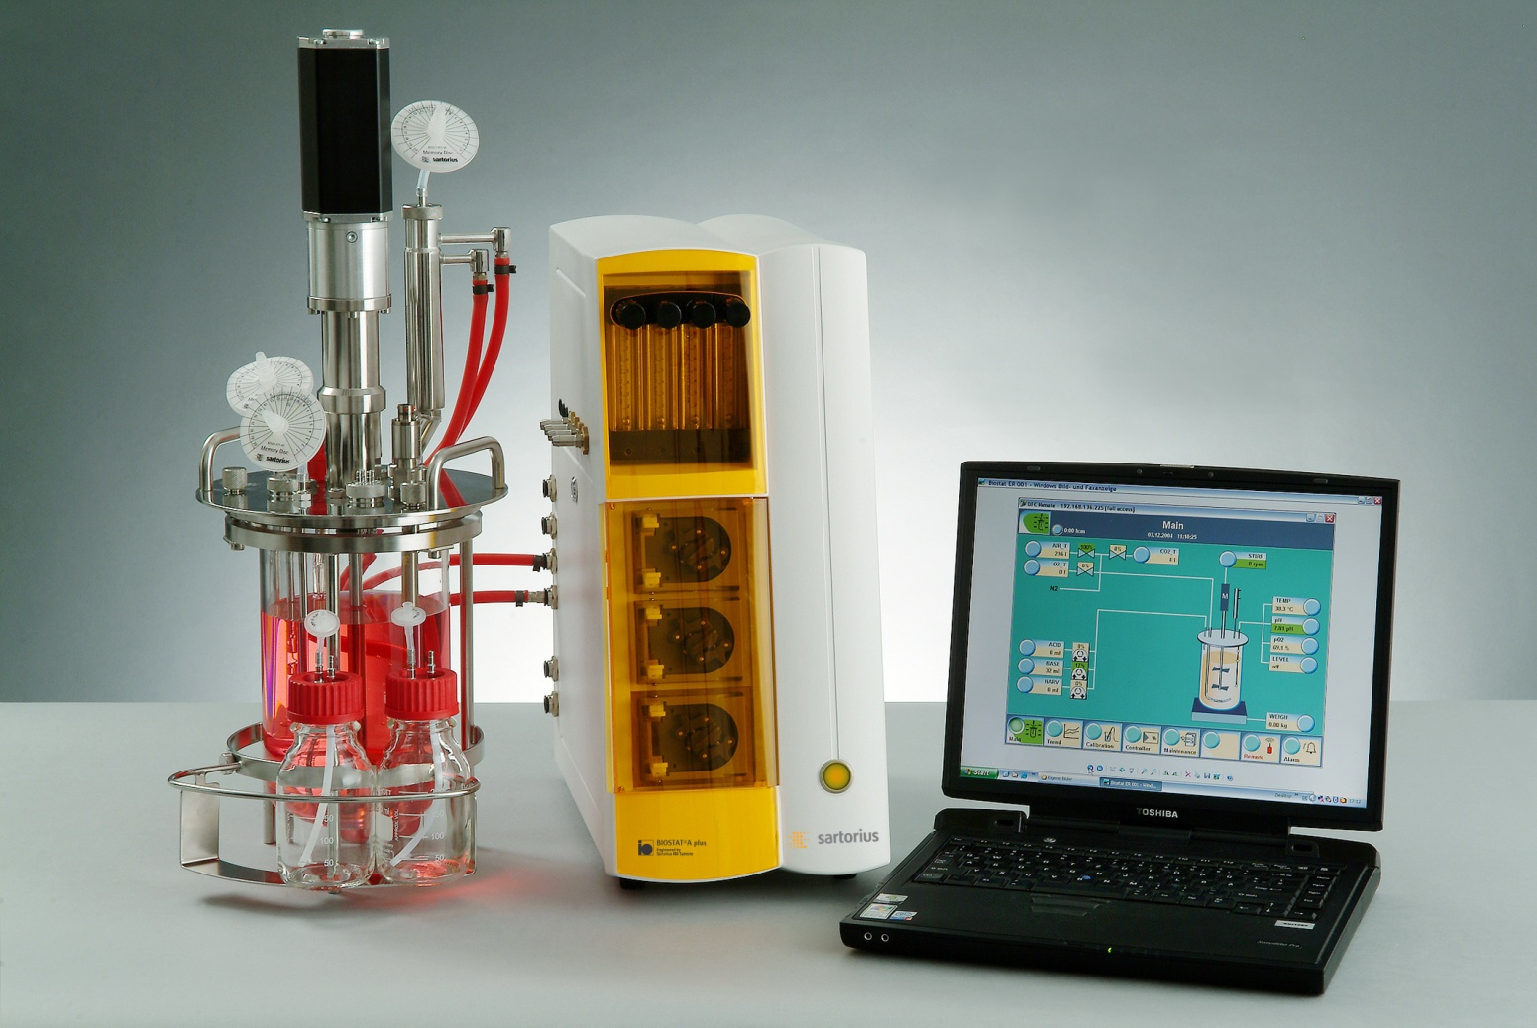
Controller
supplying gas, acid or base etc
Computer controlling bioreactor
Bioreactor with cells

Slide 8
Step 2- : Harvesting and Initial Purification Steps
Location of Product
Is it inside the cell?
Can be separated from media by centrifugation and concentrated in the cell pellet E.coli product (GFP) is kept
Is it outside the cell?
Product is in the media and is diluted
It often needs to be concentrated
Mammalian cells transport product out of cell

Slide 9
Isolation of GFP from Transformed E. Coli
Step1 - If product is retained in cell:
Transfer all contents of media + cells into a centrifuge tube once cell growth is achieved
Place this tube plus balancing tube into centrifuge and spin at selected speed
Remove tube with cells and a pellet should present (since GFP glows, check tube with UV light to determine the location of GFP)

Slide 10
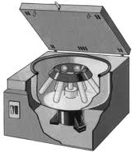
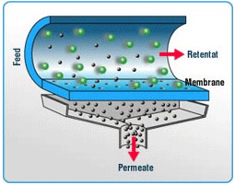
Centrifugation and Tangential Flow Filtration (TFF)
Separates by centripetal force acting on different sized particles
Centrifuge
TFF process
Tangential Flow Filtration separates molecules by membrane pore size
rotor
Novasep.com
Glossary.periodni.com

Slide 11
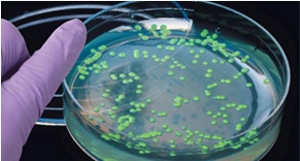
Pelleted Cells Will Glow under UV After Centrifugation
media
After
spinning
Cell pellet
Seen under UV light
Colony is placed into media containing penicillin and arabinose and grown

Slide 12
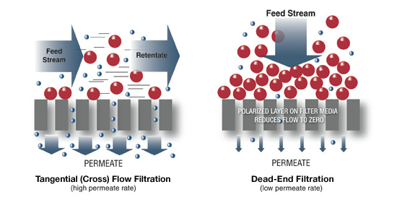
Tangential Flow Filtration Downstream Processing
This technique allows large volumes of media to be concentrated, removal or exchange of salts in solutions etc.

Slide 13
Lysing Cells to Release Product
Cells must be broken open to release product from the intracellular space . This can be done by the following means:
Freeze/thawing of cell pellet will break open the cell wall. (requires freezing pellet). Addition of lysozyme facilitates process
Homogenize pellet by grinding with specially designed homogenizers (is frequently used and requires less time)
Sonication will break open membranes in an efficient way

Slide 14
Basics of Chromatography
What is it?
Components are distributed between two phases
Stationary phase
Mobile phase which moves across the stationary phase
A Physical method that gently separate mixtures
Different rates of moving over the stationary phase separates different molecules
It is a very gentle process: does not denature proteins
Large amounts of product can be reliably isolated
Proteins that differ by one amino acid can be separated by this method

Slide 15
Types of Low Pressure Liquid Chromatography (LPC)
Adsorption
Ion Exchange
Molecular Size Exclusion
Affinity

Slide 16
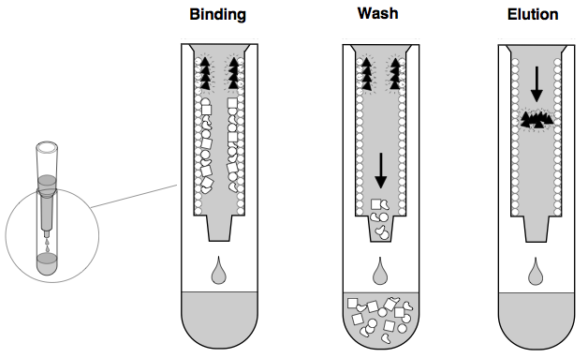
Adsorption Chromatography
Hydrophobic Interaction Chromatography
uses a mobile liquid or gaseous phase that becomes adsorbed to the stationary phase
differences in adsorption separate molecules

Slide 17
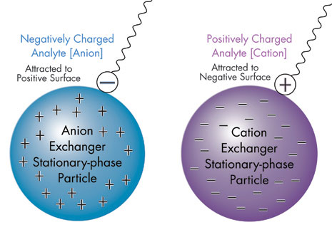
Ion Exchange Chromatography
Electrostatic forces attract oppositely charged ions between molecules in mobile and the stationary phase
The strength of the attraction determines how long a molecule will stays on the resin resulting in separation

Slide 18
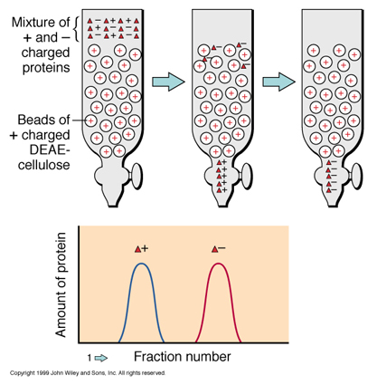
Anion Exchange Columns and How They Work cont’d
Positively charged Ions do not attach to resin & pass through
Negatively charged ions attach to the column

Slide 19
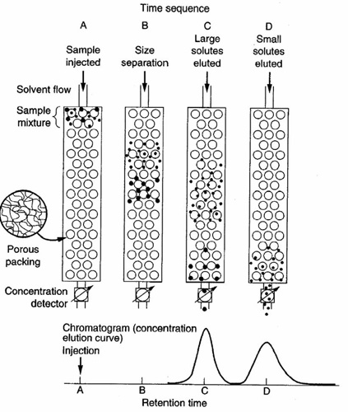
Molecular Size Exclusion Chromatography
Small molecules are last to emerge from the column
Mixtures of differently sized molecules are added to the column
Large molecules will be eluted first, smallest last
Column resin must not
be disturbed since all
sized molecules will pass through the channels
.
Bead size allows only small molecules into the bead
Siumed.edu

Slide 20
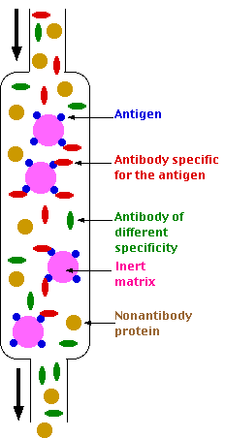
Affinity Chromatography
Affinity Column
How it is used
1. Stationary phase has an antigen covalently attached to the fixed resin
2. A mixture containing the antibody that can recognize the antigen will attach to it non-covalently
3. The substances in the mixture not wanted are washed out from column
4. The elution step releases the antibody from the antigen on the column by high salt or low pH resulting in a pure antibody being collected from column

Slide 21
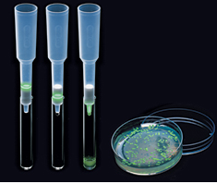
Column Chromatography of GFP

Slide 22
Standard Operating Procedures
You will be purifying the original mixture from GFP transformed E.coli cells using column chromatography
Harvest cells by centrifugation and add lysozyme. Place in freezer overnight
Centrifuge the treated cells after defrosting them to collect the supernatant for columns
SOP’s for each step is found in your workshop book, starting on pages

Slide 23
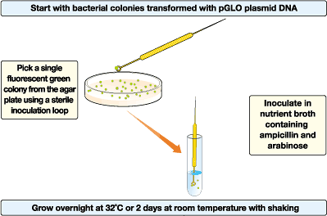
Day 1-Growing Transformed Cells
1

Slide 24
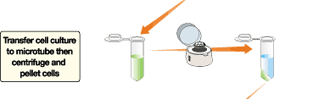
Day 2
Cells must be lysed; freezing and thawing works well.

Slide 25
HIC Columns
Some proteins are hydrophobic or water hating
High salt concentration causes protein to fold exposes hydrophobic regions to outside and proteins stick to the column
When low salt buffer is added, hydrophilic areas are exposed – protein is released

Slide 26
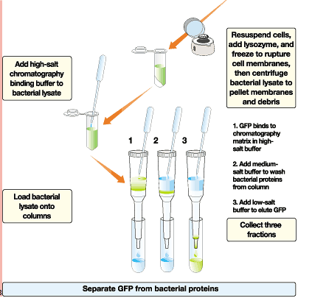
Day 3

Slide 27
Four Different Buffers for Use in Column
Equilibration buffer- 2M ammonium sulfate
Binding buffer- 4M ammonium sulfate
Wash buffer- 1.3 M ammonium sulfate
Elution buffer- low salt TE buffer

Slide 28
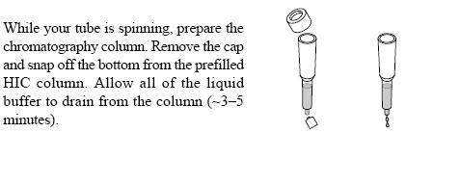
Preparation of HIC

Slide 29
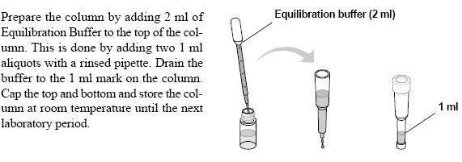
Equilibration Buffer

Slide 30
Purification Step 1
Label three collection tubes 1,2,3
Place column into tube 1 and allow liquid to run through column
Place 250 ul of supernatant onto the top of the column
Let the liquid empty from column
Move column to tube 2

Slide 31
Purification Step 2
Add 250 ul of wash buffer to the column and allow all liquid to empty into tube 2
This allows most of the cellular proteins to be rinsed through column
GFP protein should still be attached to column

Slide 32
Purification Step 3
Move column to test tube 3
Finally, add 750 ul of TE buffer (low binding) to
column and allow it to run completely through
into test tube 3
This buffer should elute the GFP protein

Slide 33
Examination of test tubes
Examine all three test tubes by viewing under a UV light
Which test tubes should contain the GFP?
Compare your results with the expected ones on next slide
Secure all your column fractions needed for SDS PAGE analysis

