Slide 1
Stem Cells
Key Words: Embryonic stem cells, Adult stem cells, iPS cells, self-renewal, differentiation, pluripotent, multipotent, Inner cell mass, Nuclear transfer (Therapeutic cloning), Feeder cells, LIF, embryoid body.

Slide 2
What are stem cells?
Cells that are able to renew themselves (Self-renewal) indefinitely, while producing cell progeny that mature into specialized cells (Differentiation).
Throughout our lives, stem cells in our body regenerate cells to renew damaged tissues such as skin and blood.
Found throughout your life in tissues, blood, bone marrow and adipose.

Slide 3
Types of stem cells
Embryonic stem cells- can generate all cell types (Pluripotent vs. Totipotent)
Adult stem cells (also called somatic or tissue-specific stem cells)- can generate cell types within a specific tissue or organ (Multipotent)
Induced pluripotent stem cells (iPS)- engineered from specialized cells (Pluripotent).
Notes:
Pluipotent cells have the potential to become any cell type (except for trophoblast).
Multipotent cells can differentiate into cells within a specific tissue.

Slide 4
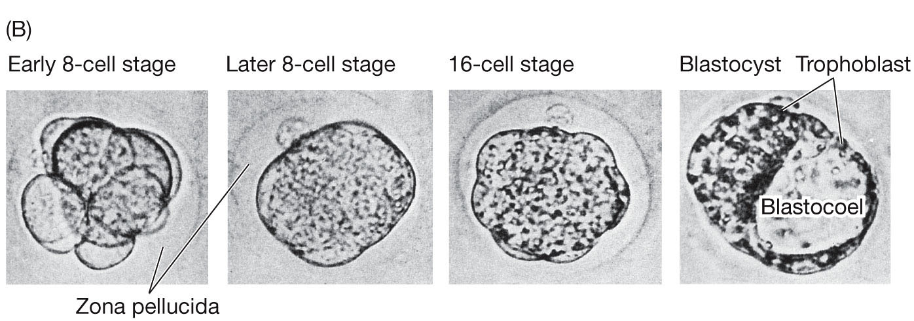
Embryonic stem cells (ESC)
Embryonic stem cells are obtained from the inner cell mass of blastocysts
Blastocyst is formed early in the development (5 days after fertilization).
Inner cell mass
Notes:
Sadava et al.
Life Eighth edition Figure 43.4

Slide 5
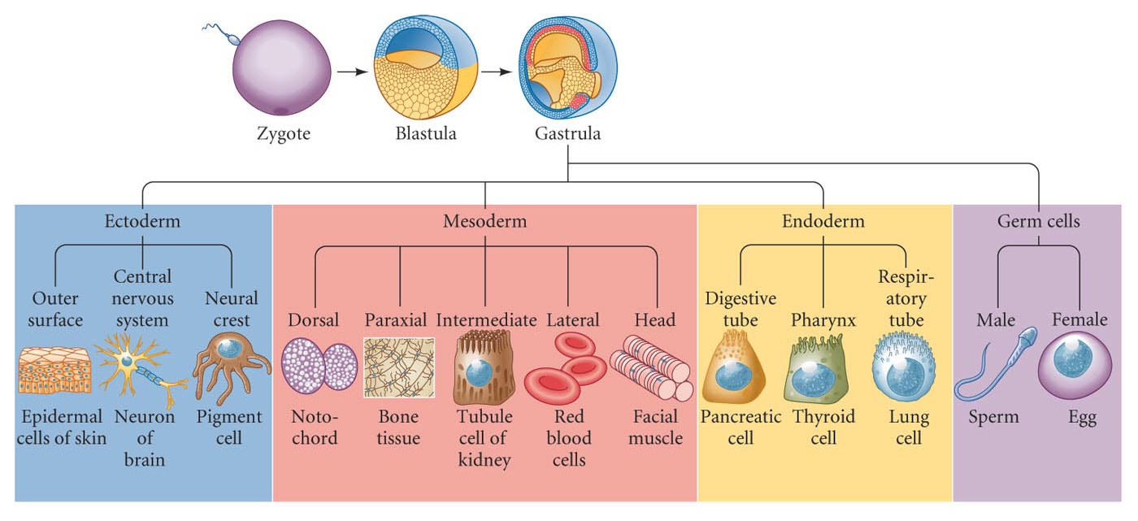
Early Development:
Cells are Segregated Into 4 Different Cell Types:
Ectoderm, Endoderm, Mesoderm, and Primordial Germ Cells
[Image taken from Gilbert’s “Developmental Biology”, 8th edition, Sinauer].
Notes:
From Stanford stem cell

Slide 6
Differentiation
The process by which cells develop into specialized cells with specific functions and structures.

Slide 7
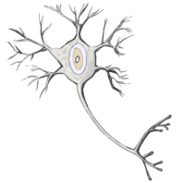
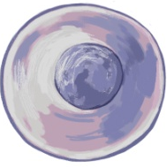
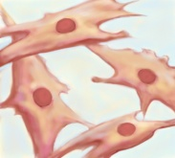
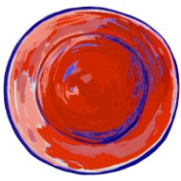
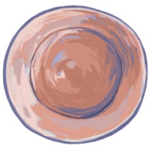
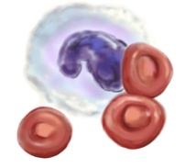
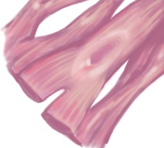
Differentiation into specialized cells
Totipotent
Pluripotent
Multipotent
Unipotent
brain
Ectodermal cell
skin
bone
marrow
Zygote
ES cell
Mesodermal cell
heart
Primitive
progenitor
cells
Differentiated
cells
Image from Stanford stem cell
Notes:
• ES cells from the inner cell mass can give rise to all three germ layers and are pluripotent
• Cells in each germ layer retain the ability to proliferate and give rise to a more restricted spectrum of cells, and are said t be multipotent.
• Eventually proliferating precursors or progenitors appear that have very limited eventual fates and are unipotent, such as a neuron or a skin cell
• Stem cells or progenitors thus undergo successive steps of lineage restriction that limit the eventual cell types they can produce

Slide 8
Applications for stem cells
Potential to treat or cure diseases by tissue replacement
A model to study early human development and developmental disorders
A model to study gene regulation and development
Drug discovery and toxicology studies
Used to supply cells for the repair of damaged or diseased organs
Examples:
Bone marrow transplantation
Skin replacement
Blood disorder treatments
(Dry) Macular degeneration
www.isscr.org
Notes:
www.isscr.org

Slide 9
Sources of Embryonic stem cells
Blastocysts created in culture for IVF (in vitro fertilization) that are not implanted into uterus
Therapeutic cloning

Slide 10
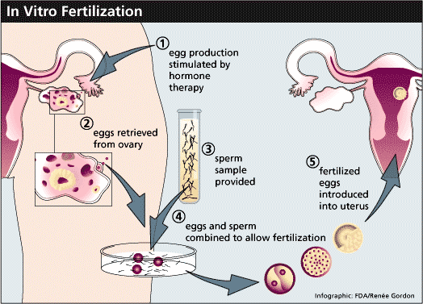
Sources of ES cells
Sources of ES cells
In vitro fertilization (IVF):
  Isolate sperm and egg from male and female, mix together → fertilized egg (zygote)
  Cultured for 2-5 days → blastocysts
  Blastocysts implanted into uterus
  Many are not implanted into uterus, and can be used to make ES cells

Slide 11
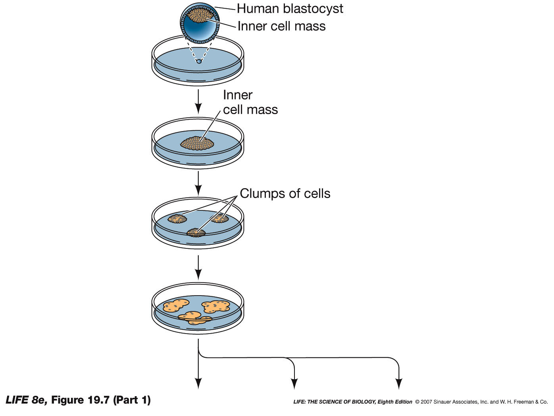
Isolation of embryonic stem cells from the blastocyst.

Slide 12
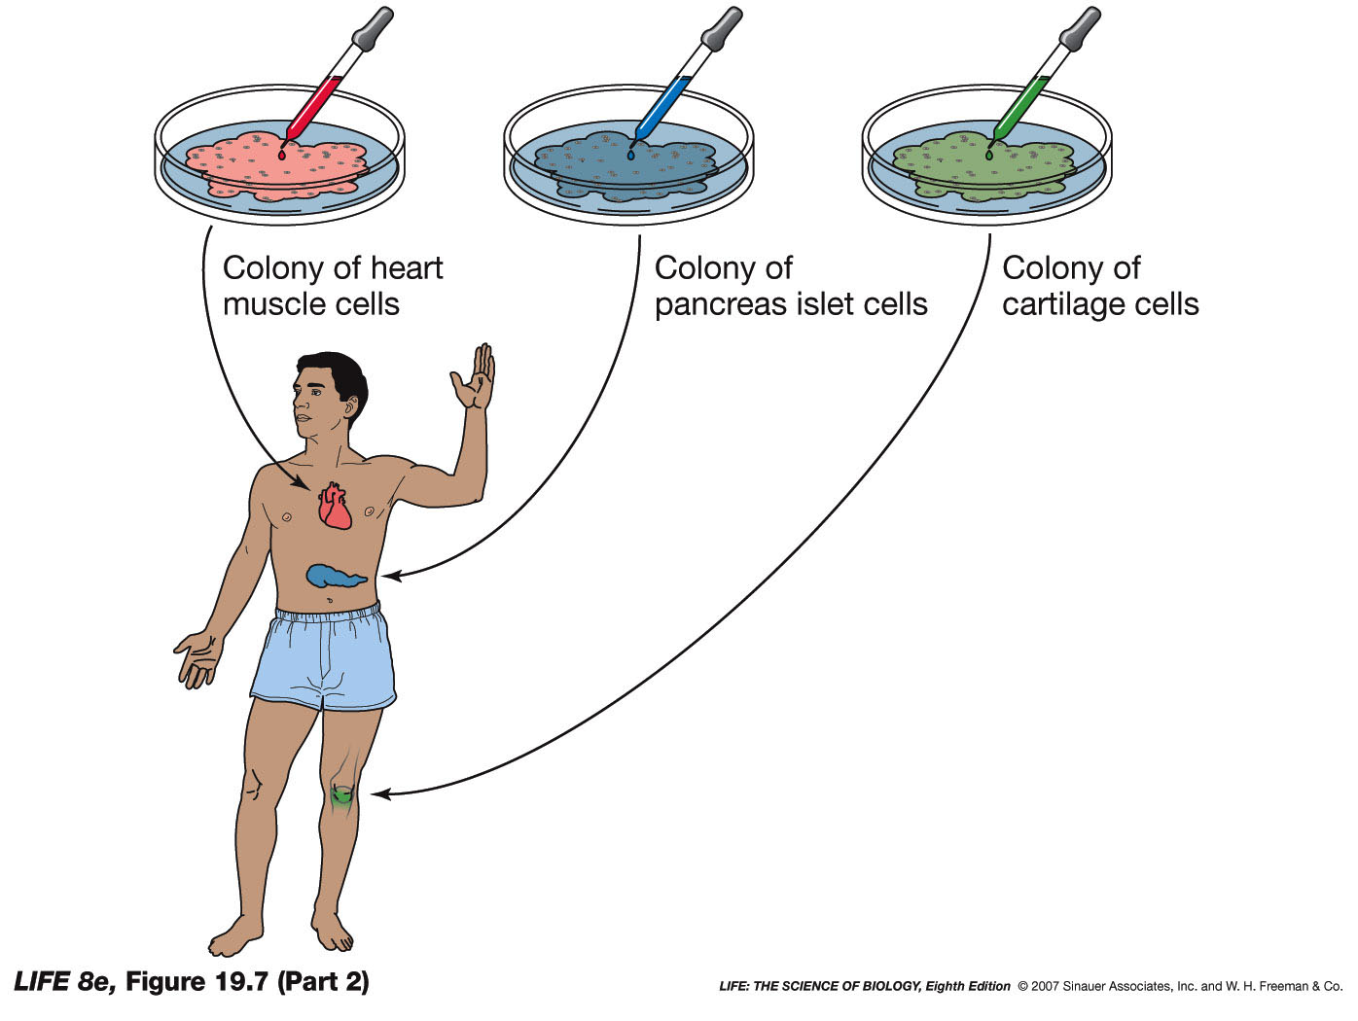

Slide 13
Therapeutic or patient-specific cloning (Nuclear transfer)
Used to avoid immune rejection from the patient.
The blastocyst that is generated this way is not implanted in the uterus (reproductive cloning) and therefore it does not develop into an embryo.
Has been successful in mice but difficult in humans.

Slide 14
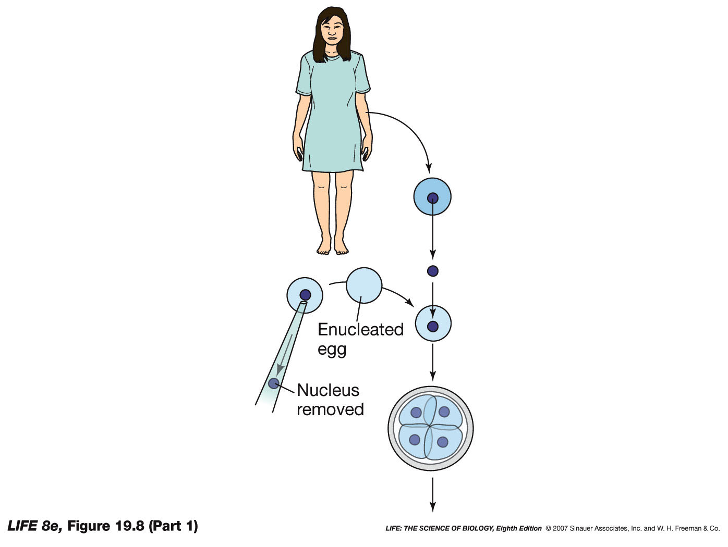
Therapeutic Cloning
nucleus of an egg is replaced by the nucleus of the patient’s cell
Notes:
The nucleus of an egg is replaced by the nucleus of the patient’s cell and grown in culture to form a blastocyst, from which stem cells are isolated and further grown in culture.

Slide 15
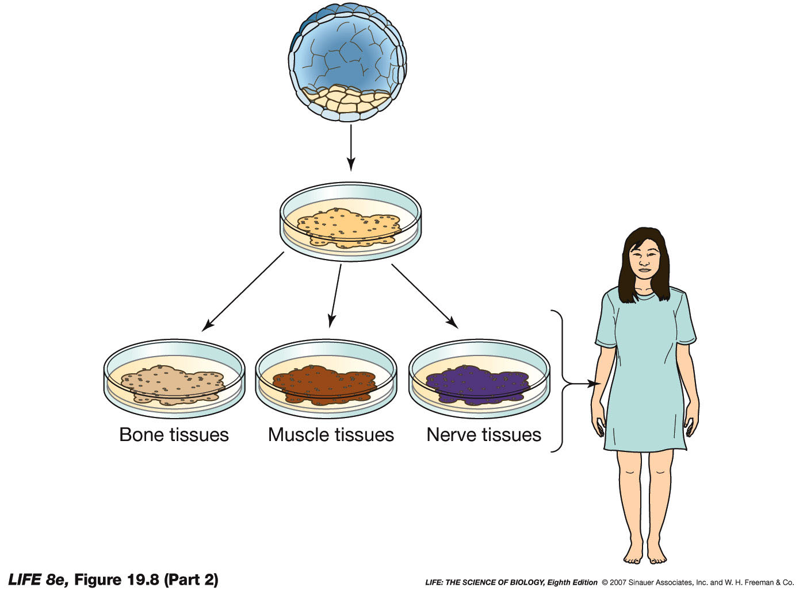

Slide 16
Disadvantages of embryonic stem cells
Difficult to induce certain differentiation pathways
Can trigger immune response in the recipient individual (unless therapeutic cloning is used to generate stem cells)
Could become cancerous (teratoma tumors)
Controversial ethical and political issues

Slide 17
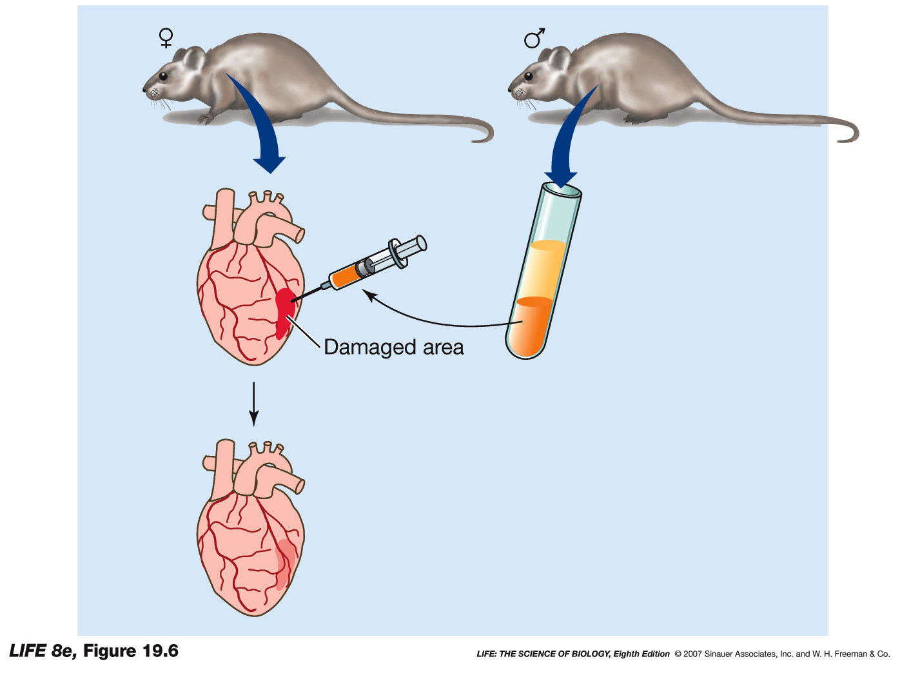
Adult stem cells from a healthy mouse are injected into damaged heart of another mouse.
Repaired heart
Notes:
A Heart attack caused damage to the heart muscles of the female mouse
Adult stem cells were taken from an adult male mouse and were injected into the females damaged heart
In two weeks the damaged heart was regenerated partially.

Slide 18
Culturing of embryonic stem cells
The inner cell mass of the blastocyst is separated from the trophoectoderm that surrounds it.
The cells are cultured in a culture dish with or without feeder cells.

Slide 19
Feeder Cells
Feeder cells are non-invading cells, usually mouse embryonic fibroblasts that have been inactivated so they do not divide.
Feeder cells provide various growth factors and contact embryonic stem cells.
Feeders help the ESCs to maintain their pluripotency.
Since feeder cells can potentially contaminate the stem cells it is preferred to grow stem cells without feeders.
Notes:
A layer of feeder cells are plated first. After a day when the feeders are attached to the plate. Stem cells are plated on top of the feeders. Factors secreted by the feeders maintains the pluripotency of the stem cells.

Slide 20
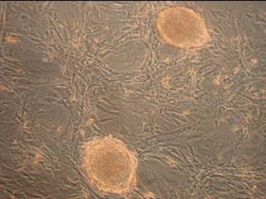
Mouse ES cells growing on feeders.
ES Cell Clusters
Feeders (Mouse Embryonic Fibroblasts)
Notes:
Picture from Gladstone (Carin Z)

Slide 21
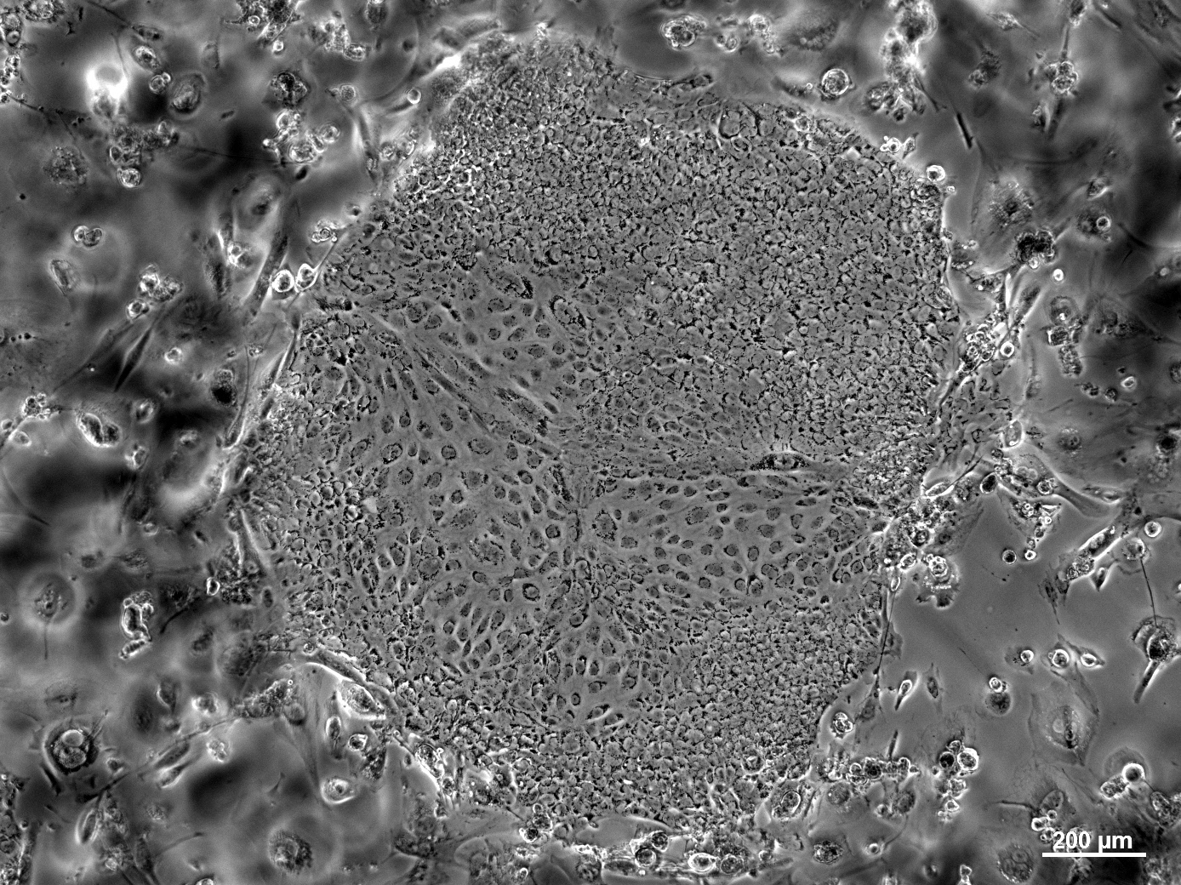
Human embryonic stem cell colony growing on feeders.
Notes:
Gladstone (Golnar A)

Slide 22
Stem cells in culture tend to aggregate to form colonies. In some colonies cells may differentiate spontaneously.
To prevent differentiation, cells need to be passaged (subcultured) frequently.
The colonies are removed and dispersed into single cells and cultured again.

Slide 23
Leukemia Inhibitory Factor (LIF)
Mouse embryonic stem cells can keep their pluripotency without feeder cells if LIF is added to the media.
LIF binds LIF-receptors on the surface of mouse ES cells and triggers activation of the transcription factors that are necessary for continued proliferation.
LIF is added to the media to inhibit differentiation of the cells and to maintain their self-renewal property (Pluripotency).
To trigger differentiation, LIF is removed from the culture.
Human ESCs are not responsive to LIF. Human ESCs can grow in undifferentiated state without feeders if the media has been conditioned with human or mouse cells before use.

Slide 24
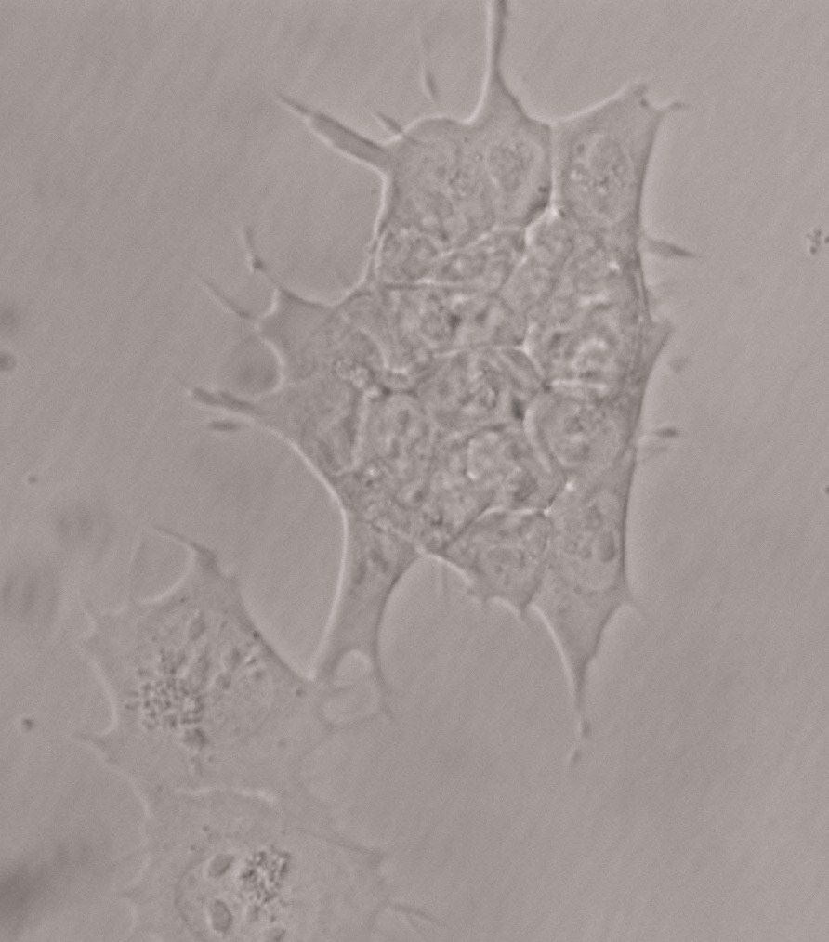
Feeder Independent mESC cultured in the presence of LIF (Leukemia Inhibitory Factor)
Notes:
Photo by Golnar A

Slide 25
Differentiation Method
ES cells differentiate spontaneously into all three forms of cells (ectoderm, mesoderm and endoderm) if the right conditions are provided
To trigger differentiation, ES cells are grown in the absence of LIF and on uncoated plates to prevent adhesion to the plates.
The cells form aggregates (spheres) called embryoid bodies.
Differentiation initiates spontaneously upon aggregation of cells.
Under appropriate culturing conditions ESCs can be directed to differentiate into specific cell types.

Slide 26

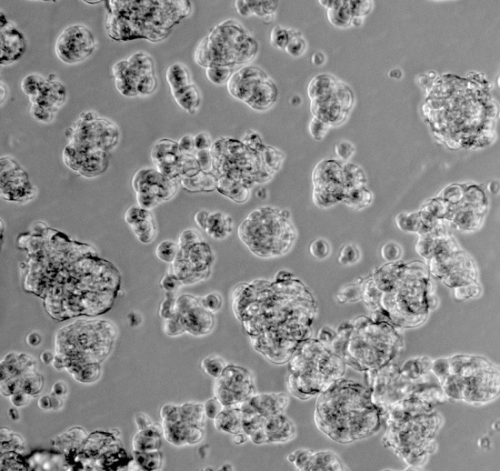
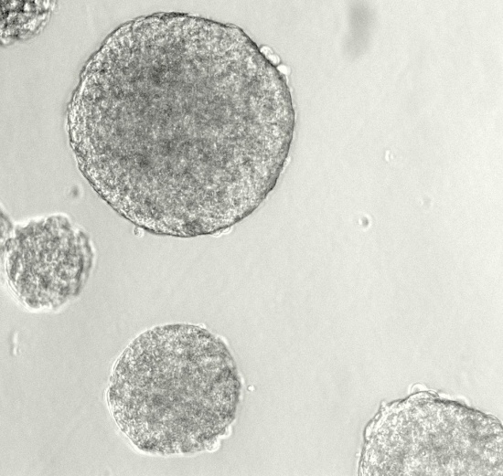
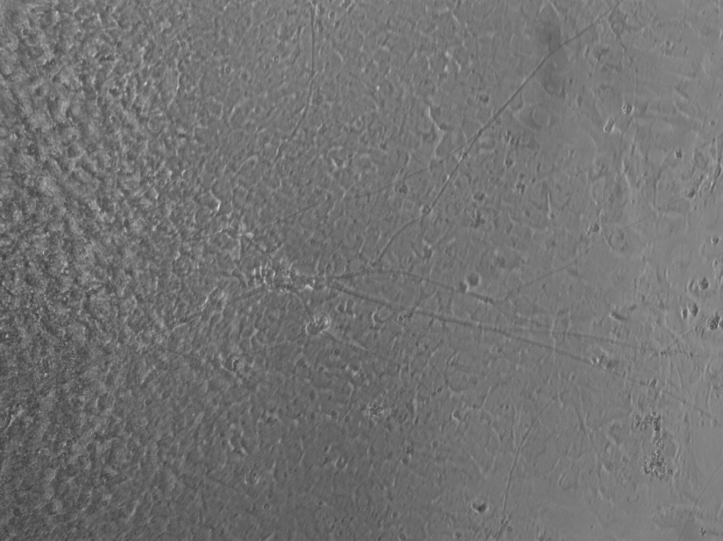
Pluripotent ESCs
ESCs in suspension
Week 1- Floating EBs
- LIF
+ RA
Week 2-Differentiated neurons
Notes:
Adding retinoic acid to the media during differentiation, guides the stem cells to differentiate into neurons.
Notice the long axons of the differentiated neurons.
Photos by Golnar A

Slide 27
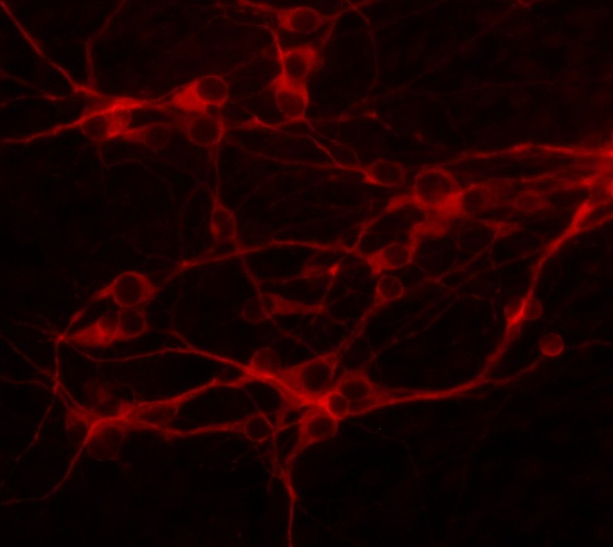
Differentiated neurons
MAP2 protein in red
Notes:
Differentiated neurons were fixed and stained with anti-MAP2. Fluorescent labeled secondary antibody was used to visualized MAP2 proein. MAP2 or Microtubule Associated protein-2 is found only in nerve cells. MAp2 is present I the cytoplasm.
Photo by Golnar A

Slide 28
What’s Been Done to This Point
mESC (E14) grown using enriched pluri-potent media (PPM)
  DMEM / high glucose
    L-glutamine
    Sodium pyruvate
    Non-essential amino acids
    2-mercaptoethanol
    Luekemia Inhibitor Factor (LIF)
  T-25 tissue culture vessels to adhere

Slide 29
What’s Been Done to This Point
Day 1 – Monday, 7/8
  Plated as suspension in low-binding plates => embryoid bodies (Ebs) in differentiation media
  Feed at day 3
Begin Directed Differentiation
  day 5 of EB culture - transfer Ebs
  Half in Differentiation Media => spontaneous
  Half in Differentiation Media w/ 5 uM Retinoic acid => directed to neurons

Slide 30
What You Will Do Today
Treat 24-well TC plate with 0.1% gelatin
Harvest Ebs
  10 miutes in centrifuge tube (incubator)
  Aspirate and replace media
  Half in Differentiation Media => spontaneous
  Half in Differentiation Media w/ 5 uM Retinoic acid => directed to neurons

Slide 31
What You Will Do Today
Dispense into treated wells at 5 to 10 Ebs per well
Issues
  Aseptic transfers
  Treat Ebs gently, especially when resuspending
  Will the Ebs cooperate => cardiomyocytes and neurons

Slide 32
Differentiated neurons
Notes:
Differentiated neurons were fixed and stained with anti-MAP2. Fluorescent labeled secondary antibody was used to visualized MAP2 proein. MAP2 or Microtubule Associated protein-2 is found only in nerve cells. MAp2 is present I the cytoplasm.
Photo by Golnar A

Slide 33
Cardiomyocytes

Slide 34
Glossary
Stem cells- Cells that are able to renew themselves indefinitely, while producing cell progeny that mature into specialized cells. (Self renewal and differentiation)
Self-renewal- The ability of cells to divide and produce more of themselves
Differentiation- The process of development with an increase in specialization
Blastocyst- A very early embryo. Contains the inner cell mass which forms the embryo and trophoblast that forms the placenta.
Therapeutic cloning- The use of cloning by nuclear transfer to produce an embryo that will provide embryonic stem cells to be used in therapy.
Multipotent stem cells- Stem cells whose progeny are able to mature into multiple differentiated cells, but all within a particular tissue.
Pluripotent stem cells- Stem cells that can become all cell types. Except for trophoblast.
Totipotent cells- Zygote and the first cells that are produced in the days of development before blastocyst formation . These Cells can become all cell types.
Embryoid body- Spheroid colonies seen in culture produced by the growth of embryonic stem cells in suspension.
Sadava et al 2007
www.isscr.org

