Slide 1
Quality Control Biotechemistry

Slide 2
Common Process Compounds and Methods of Removal or Purification
Component | Culture Harvest Level | Final Product Level | Conventional Method
Therapeutic Antibody | 0.1-1.5 g/l | 1-10 g/l | UF/Cromatography
Isoforms | Various | Monomer | Chromatography
Serum and host proteins | 0.1-3.0 g/l | < 0.1-10 mg/l | Chromatography
Cell debris and colloids | 10⁶/ml | None | MF
Bacterial pathogens | Various | <10⁻⁶/dose | MF
Virus pathogens | Various | <10⁻⁶/dose (12 LRV) | virus filtration
DNA | 1 mg/l | 10 ng/dose | Chromatography
Endotoxins | Various | <0.25 EU/ml | Chromatography
Lipids, surfactants | 0-1 g/l | <0.1-10 mg/l | Chromatography
Buffer | Growth media | Stability media | UF
Extractables/leachables | Various | <0.1-10 mg/l | UF/ Chromatography
Purification reagents | Various | <0.1-10mg/l | UF

Slide 3
What Will Change During Scale-up? Process Development Considerations
Utility requirements
Water requirement
Cleaning/Sanitizing solution requirements
Buffer prep
Number of steps in cell culture scale up
Harvest techniques
Column packing; distribution of introduced liquid at large columns
Equipment – bubble trap
Automation of process
Data collection
Sample load

Slide 4
Quality Control Biochemistry
HPLC (High Pressure Liquid Chromatography)
IEF (Isoelectric Focusing)
ELISA (Enzyme-Linked Immunosorbent Assay)
SDS-PAGE (Sodium Dodecyl Sulfate-Polyacrylamide Gel Electrophoresis)

Slide 5
Quality Control Biochemistry: ELISAs and SDS-PAGE
Each of these methods is important in the Downstream Processing of the Protein of Interest:
IEF (Isoelectric Focusing): Use an SDS-PAGE gel box (or CE = capillary electrophoresis) to determine the pI or the pH at which the protein of interest is neutral.
ELISAs: Use antibody reagents and a microtitre plate reader to determine the concentration and/or the activity of a protein of interest.
SDS-PAGE: Use acrylamide gel electrophoresis to separate proteins according to molecular weight (a single band indicates purity – if validated to do so).

Slide 6
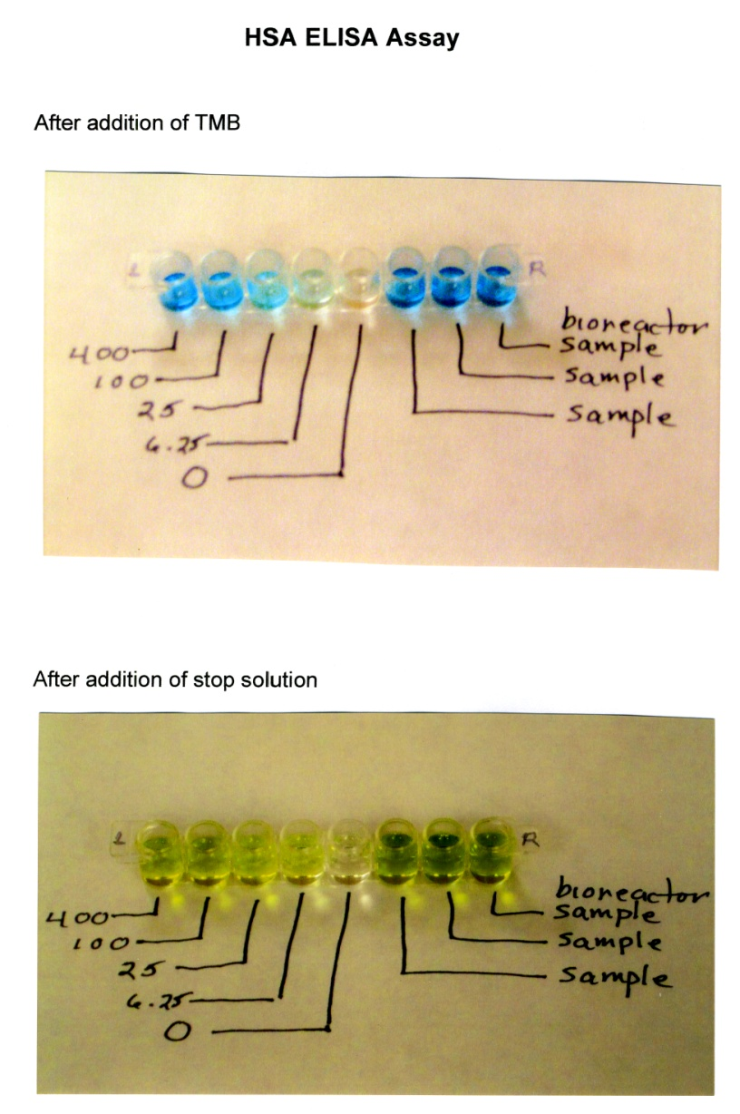
ELISAs
There are several types of ELISAs including direct (sandwich), indirect, competitive and activity ELISAs. ELISAs are read on a microtitre plate reader which is a mini-spectrophotometer that determines the absorption or transmission of a beam of light of a particular wave length passing through a solution of the protein of interest. Using standards to generate a standard curve, one can determine the concentration of the protein of interest in a sample.

Slide 7
HSA ELISA Results Spring 2009 Data
Concentration ng/ml | OD
0 | 0.071
6.25 | 0.169
25 | 0.426
100 | 0.951
400 | 1.156
Sample 1 | 1.320
Sample 2 | 1.290
Sample 3 | 1.290

Slide 8
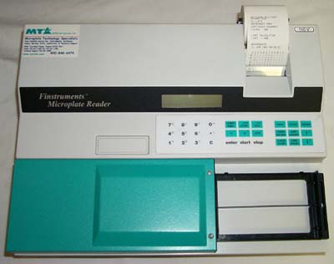
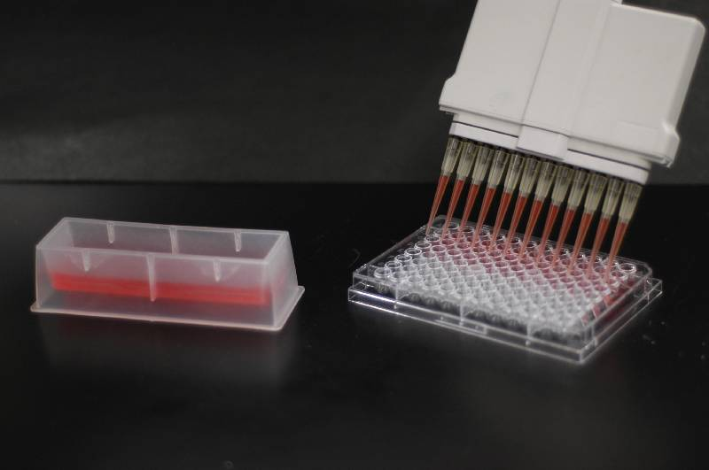
ELISA Equipment
Multi-Channel Pipettor
Microtitre Plate Reader

Slide 9
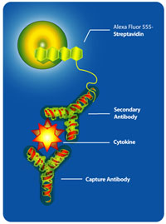
ELISA Process
To make an ELISA, one must utilize antibodies to the protein of interest. The first antibody recognizes the protein of interest. The second antibody recognizes another epitope on the protein of interest and carries an enzyme that will be used to quantify the protein of interest.

Slide 10
ELISA Process – Colorimetric Reaction
Colorless
substrate
TMB
Colored product

Slide 11
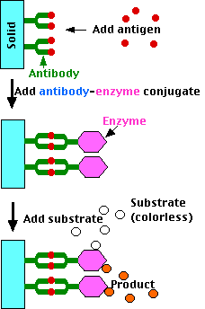
ELISA Continued
ELISA = Antibody Sandwich

Slide 12
Antibodies as Reagents
ELISAS are Immunoassays which use an antibody (Ab) to detect and quantify substances
Ab are extremely specific – ADVANTAGE
Ab can not be detected, need a marker:
Radioactive labels (RIA)
Enzymes (EIA) – Horseradish Peroxidase; Alkaline Phosphatase
Fluorescent Tag (FIA)
Chemiluminescencent Tag

Slide 13
ELISA Animation
The animation may be found at: usmlemd.wordpress.com/2007/06/12/elisa-test/

Slide 14
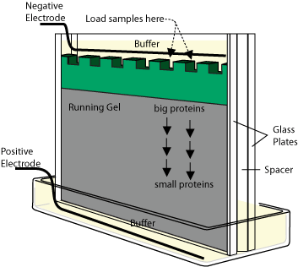
SDS-PAGE
SDS-PAGE Gel Box
SDS-PAGE Overview
SDS Polyacrylamide gels (SDS-PAGE) are called “denaturing gels” because they contain sodium dodecyl sulfate (SDS), an ionic detergent that binds to the amino acid residues in the proteins. Due to its ionic properties, SDS confers a net negative charge on all the proteins, overcoming any intrinsic charge; in this way the proteins uniformly migrate toward the positive electrode. SDS also disrupts the secondary and tertiary structure of the proteins, essentially destroying their globular configuration and making them into linear molecules that then migrate in the electric field on the basis of their size. PAGE is a very powerful technique because even small differences in molecular weights produce distinguishable bands on a gel.

Slide 15
Electrophoresis
SDS-PAGE Continued
SDS-PAGE
separate proteins based on molecular weight
Isoelectric Focusing
identify the pH at which a protein carries no net charge

Slide 16
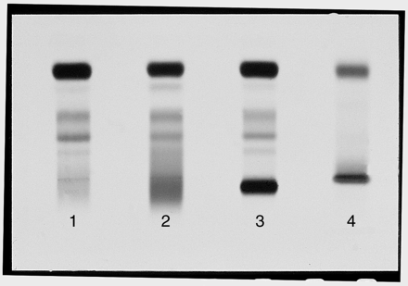
SDS-PAGE Continued
Sodium Dodecyl Sulfate - Polyacrylamide Gel Electrophoresis
developed by Laemmli (1970)
Notes:
SDS is a negatively charge detergent which
DENATURES the protein (what does this mean?)
and gives all proteins a uniform charge
SHOW FIGURE 6
This gel separates based on MW
no interference from 3D structure or charge
Smaller proteins move faster and further
Smaller the proteins being separated --Higher % of acrylamide
DDT dithiothreitol
BME B-mercaptoethanol
Break disulfide bonds
Completely disrupt the 3D structure of proteins

Slide 17
SDS-PAGE Continued
characterize (MW)
quantify (densitometry)
determine other proteins in a sample
step in Western blot (used to identify)

Slide 18
How to Detect Proteins?
SDS-PAGE Continued
Coomassie Blue Stain (0.1 ug)
Silver Stain (2 ng)
How to Quantify Proteins?
Densitometry

Slide 19
Molecular Weight Determination
Run SDS PAGE with known standards (MW markers)
Graph
Measure distance unknown protein traveled
Compare on standard curve

Slide 20
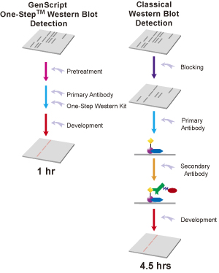
Immunoblots (Westerns)
Notes:
Run proteins SDS-PAGE
Transfer (blot) proteins
Probe the membrane with 1o antibody
Add 2o antibody
Substrate is added
Color change occurs

Slide 21
A280
Tryphophan
Phenylalanine
Tyrosine
ALL ABSORB LIGHT AT 280 nm
Crude, not necessarily quantitative
Same amount of protein will show different A280 depending on amount of above amino acids

Slide 22
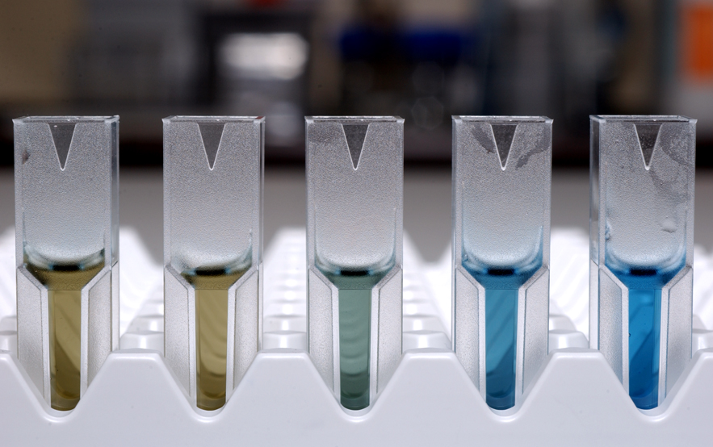
Bradford Assay
SECOND MOST CITED PAPER IN SCIENCE JOURNALS
Bradford, M. M. (1976)
A Rapid and Sensitive Method for the Quantitation
of Microgram Quantities of Protein Utilizing the
Principle of Protein-Dye Binding.
Anal. Biochem. 72:248-254.
Coomassie Brilliant Blue G Dye
Notes:
The unbound forms are green and red.
The bound form of the dye is BLUE
absorption spectrum maximum historically held to be at 595 nm

Slide 23
Protein Characterization Methods
CHARACTERISTIC | METHOD
PURITY | SDS-PAGE, 2D ELECTROPHORESIS, IEF, HPLC, MS, CAPILLARY ELECTROPHORESIS
MOLECULAR WEIGHT | SDS-PAGE, GEL FILTRATION CHROMATOGRAPHY, MS, ANALYTICAL ULTRACENTRIFUGATION
FUNCTION | MUCH VARIETY
PRIMARY STRUCTURE | AA COMPOSITION, PEPTIDE MAPPING, N-TERMINAL SEQUENCING, COMPLETE AMINO ACID SEQUENCING
SECONDARY, TERTIARY, QUARTENARY STRUCTURE | X-RAY CRYSTALLOGRAPHY, NMR, ANALYTICAL ULTRACENTRIFUGATION, FLUORESCENCE SPECTROSCOPY
POST-TRANSLATIONAL MODIFICATION | DEPENDS ON TYPE OF MODIFICATION

Slide 24
Quality Control Biochemistry: Some Additional Techniques
Mass Sepctrometry
Amino Acid Sequencing
X-ray Crystallography
Nuclear Magnetic Resonance

Slide 25
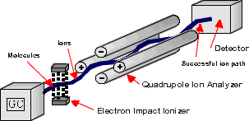
Mass Spectrometry
Molecular Weight determination
More accurate than SDS PAGE
Less protein needed for analysis than SDS PAGE
Notes:
MALDI MS matrix-assisted laser desorption and ionization
mix protein with matrix (absorb UV rad)
bombard mixture with UV photons
matrix absorbs UV - flight into gas phase
protein becomes ionized
electric field pulls protein through analyzer tube

Slide 26
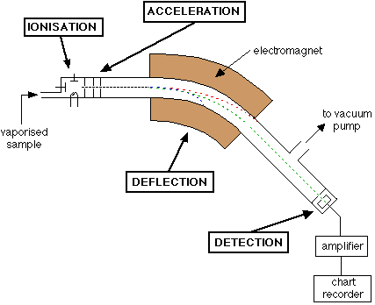
Mass Spectrometry

Slide 27
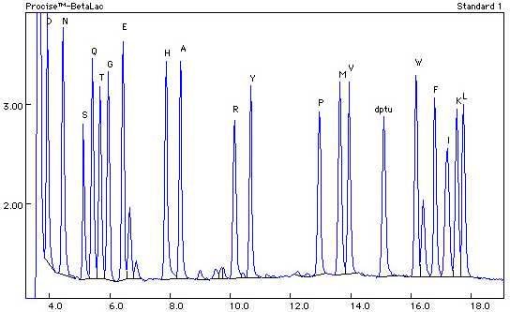
Amino Acid Sequencing
Edman Degradation
Notes:
only works with 50 -70 aa fragments
cut protein with cyanogen bromide (CNBr)
cuts on carboxyl side of mets
Phenylisothiocyanate
binds to and releases N term residue
Chromatography agst known standards

Slide 28
Amino Acid Composition
Treat with HCl (hydrolysis)
Separate individual aa by ion exchange chromatography
Analyse with HPLC

Slide 29
3D Structure Determination
X Ray Crystallography
need to crystallize (Difficult)
NMR
small proteins 25kD

Slide 30
X-ray Crystallography
X ray diffraction
beam of x rays directed at protein (incident)
beam is diffracted by electrons of atoms in protein (scattered)
these beams hit a film detector
computer analysis to create electron density map
Notes:
Metal Atoms (Fe, CU) and Sulfur are effective in scattering X-rays
Protons to no work well

Slide 31
Nuclear Magnetic Resonance
uses radio frequency pulses
energy is absorbed such that electrons move from ground to excited states
atomic nuclei spin - create their own magnetic field
emit radiation - differs based on atoms or chemical groups

