Slide 1
Pipette Calibration

Slide 2
Pipette Calibration
Procedure
Pipette, water and balance
Test the maximum volume or minimum volume
Pre-wet tips
Test 5 volumes per setting

Slide 3
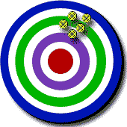
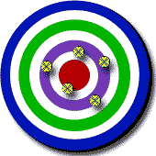
The Best of Both Worlds
Precision + Accuracy
Precision
Accuracy

Slide 4
Pipette Calibration Criteria
Calibration Acceptance Criteria
Accuracy (mean error): How close a measurement is to an accepted value. Difference between the dispensed mass and the selected volume of a pipette
Precision (random error): Indicates how close together or how repeatable the pipette volumes are. A precise measuring instrument will give very nearly the same result each time it is used.

Slide 5
Averages for Sample Weights and Correction Factors
Mean weight = sum of sample weights
of samples number of samples
Mean volume = (ave. weight + e) x Z
of samples
w = mean weight in mg
v = mean volume ul
e = evaporation rate in mg
Z = factor for correction

Slide 6
Introduction to Calibration Activity
You will be given a pipet to calibrate
Calibration will be done by using the equation
Density = Mass/volume
Using a balance that can weigh up to 0.001mg
Place a weigh boat on the balance and tare it
Adjust pipet to 100 ul and place this into

Slide 7
Calibration Activity Continued
Adjust pipet to 100 ul volume
Attach a fresh pipet tip to the end of the pipet
Press the top button down until you meet resistance
Place tip into water and slowly release button
Now place water into weigh boat on balance
Weigh the amount of water present to 1 mg

Slide 8
Calibration Acceptance Criteria
Accuracy
The closeness of a dispensed volume to the expected volume as set on the pipette
It can be determined by how close the volumes measured are to the values expected volumes

