Slide 1
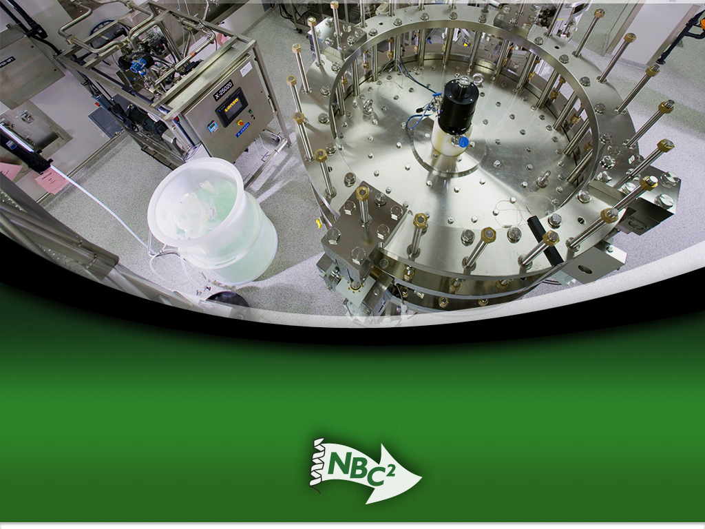
So, What is Biomanufacturing?
*Bench Top to Bottle*
Facilities in Biopharmaceutical Manufacturing
Competencies/Job and Career Opportunities

Slide 2

Basis of the Bioeconomy
Central Dogma: DNA RNA Protein
Discovery Research (DNA Centric)
Process Development and Biomanufacturing (Protein Centric)

Slide 3
The Drug Discovery, Development and Approval Process
for Biopharmaceuticals (Biologics)
DISCOVERY DEVELOPMENT LAUNCH
Testing Phase | Discovery / Preclinical Testing
Test Population | Laboratory and animals studies
Purpose | Assess safety biological activity and formulations
Success Rate | 5,000 compounds evaluated
ManufacturinActivities | Cell line construction, Cell banking
Years | 6.5
Approximate Cost | $350M
Clinical Trials
Phase I | Phase II | Phase III
20 to 100 healthy volunteers | 100 to 500 patient volunteers | 1,000 to 5,000 patient volunteers
Determine safety and dosage | Evaluate effectiveness, look for side effects | Confirm effectiveness, monitor adverse reactions from long-term use
5 enter trials
Process development, assay development, process optimization, scale-up, cGMP manufacture
1.5 | 2 | 3.5
$70M | $100M | $200M
File application
Review process / approval
1 approved
Commercial manufacture
1.5
$80M
Phase IV
Additional post-marketing testing required by FDA
=15
= $1B
File IND at FDA
File NDA at FDA

Slide 4
Career Opportunities in Biotechnology/Biomanufacturing
Research & Development
(Pre-Clinical):
Discovery Research,
Bioinformatics,
Lab Safety
Operations:
Process/Product,
Development,
Manufacturing
& Production
Quality:
Quality Control
& Assurance
Clinical Research:
Clinical Research,
Regulatory Affairs
Finance &
Administration:
Finance,
Business Development,
Administration,
Information Systems,
Legal, Facilities Management
VP of Research/Development
VP of Operations
Direction of Quality
Medical Director
VP of Finance & Administration
Discovery Research
Scientific Director
Associate Scientific Director
Principal Scientist
Senior Scientist
Scientist II
Scientist I
Senior Research Associate
Research Associate
Process/Product
Development
Director of Process/Product
Development
Process Development Supervisor
Process Development Associate
Process Development Technician
Quality Control
(QC)
Clinical Research
Clinical Research
Manager
Finance
Chief Financial Advisor
Accounting Manager
Accounting Clerk
Chemistry
QC Analyst
QC Technician
Regulatory Affairs
Manager of Regulatory Affairs
Regulatory Affairs Associate
Clinical Data Manager/Associate
Business Development
Director of Business Development
Microbiology
QC Analyst
QC Technician
Administration
Director of Human Resources
Human Resources Representative
Safety Manager
Purchasing Agent/Buyer
Receptionist
Administrative Assistant
Manufacturing
& Production
Manufacturing Supervisor
Manufacturing Associate
Manufacturing Technician
(Operator)
Manufacturing Instrumentation/
Calibration Technician
Bioinformatics
Scientist/Engineer
Analyst/Programmer
Molecular Modeler
Quality Assurance
(QA)
QA Manager/Supervisor
QA Documentation Specialist
QA Documentation Coordinator
Information Systems
Manager of Information Systems
Systems Analyst
Analyst/Programmer
Lab Facilities
Facility Manager/Supervisor
(Animal Sciences)
Veterinarian
Lab Assistant/Glasswasher
Legal
Patent / IP Attorney
Facilities Management
Facilities Manager
Facilities Technician
Shipper/Receiver

Slide 5
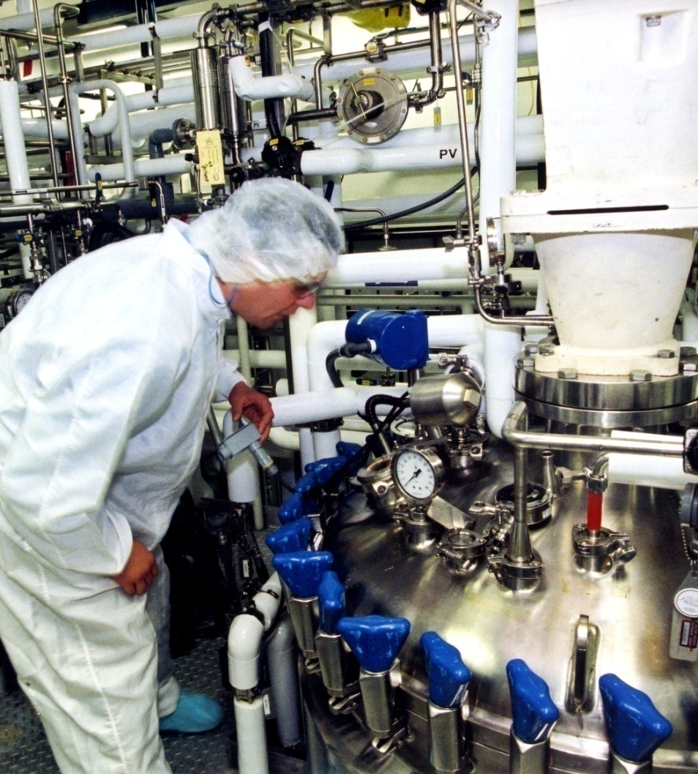
Ten Technician Jobs Anchor
Ten Biomanufacturing Departments
Facilities/Metrology
Validation
Environmental Health and Safety (EH&S)
QA
Upstream Processing
Downstream Processing
QC Microbiology
QC Biochemistry
Process Development

Slide 6
Pilot Plant – Overall Flow Plan

Slide 7
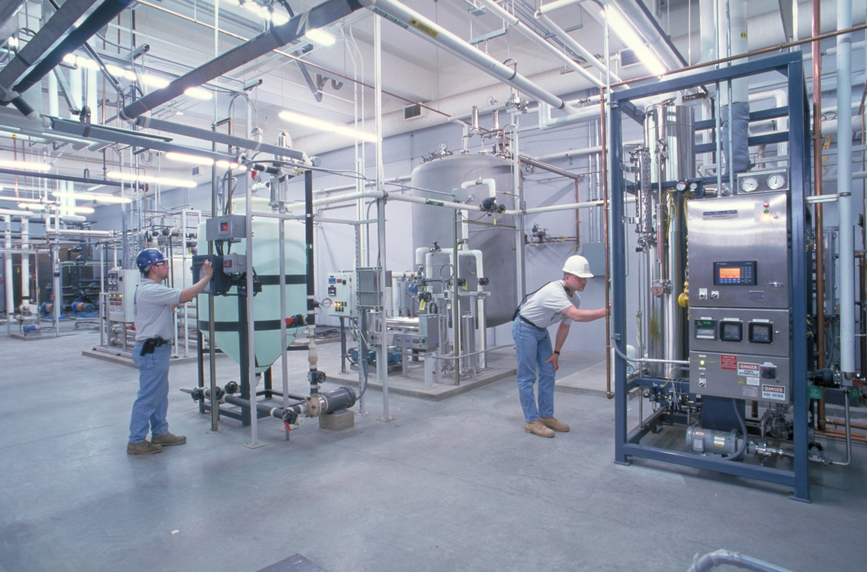
Facilities in Gray Space

Slide 8
Production Clean Rooms
Cleanrooms are Maintained by Facilities/Metrology Technicians to the Following Specifications

Slide 9
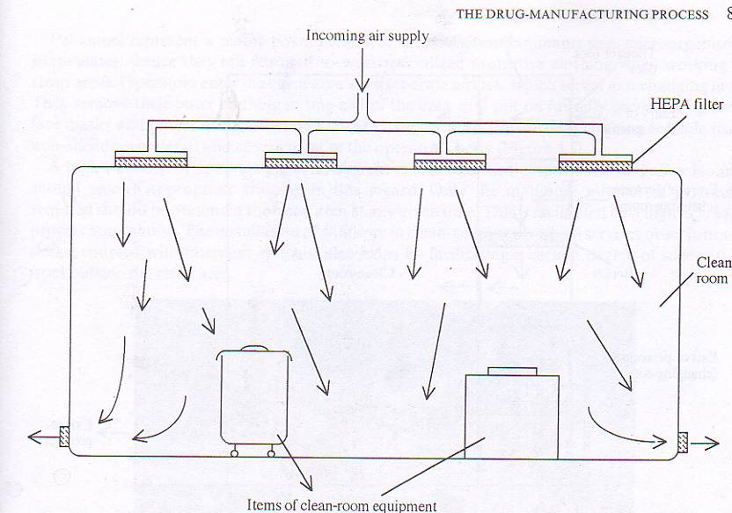
Facilities: General Cleanroom Design
HEPA filters in ceiling
Exhaust vents on floor
Seamless and rounded floor to wall junctions
Readily accessible corners
Floors, walls, and ceilings constructed of smooth hard surfaces that can be easily cleaned
Limited equipment, fixtures and personnel
Layout of equipment to optimize comfort and movement of operators
Pressure Differentials between rooms
Airlocks to control air balance

Slide 10
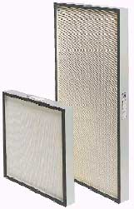
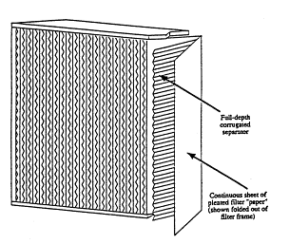
Facilities: HEPA Filters
High Efficiency Particulate Air
Minimum particle collection efficiency:
99.97% for 0.3µm diameter particles.
Disposable
Filter made of pleated borosilicate glass microfiber
http://people.deas.harvard.edu/~jones/lab_arch/nano_facilities/hepa.gif

Slide 11
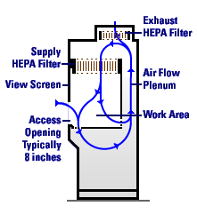
Biological Safety Cabinets
Class 100

Slide 12
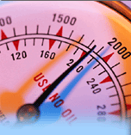
Facilities:
Pressure Differentials
Used to maintain airflow in the direction of higher cleanliness to adjacent less clean areas
A minimum of 10-15 Pascals should be maintained between the aseptic area and an adjacent room with a different clean room classifications (doors open)

Slide 13
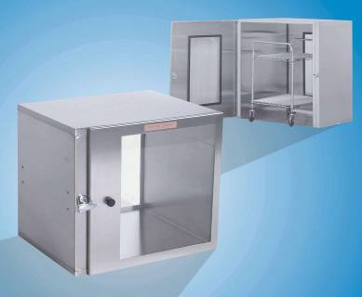
Facilities:
Airlocks
Permit the passage of objects and people into a clean room.
Consists of two airtight doors in series which do not open simultaneously.
Spray down materials with 70% IPA before placing in the airlock
http://news.thomasnet.com/images/large/451/451402.jpg

Slide 14
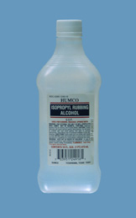
ISOPROPYL ALCOHOL
Powerful disinfectant and antiseptic
Mode of action: denatures proteins, dissolves lipids and can lead to cell membrane disintegration
Effectively kills bacteria and fungi
What is not killed by IPA?
Why are aqueous solutions are preferred?

Slide 15
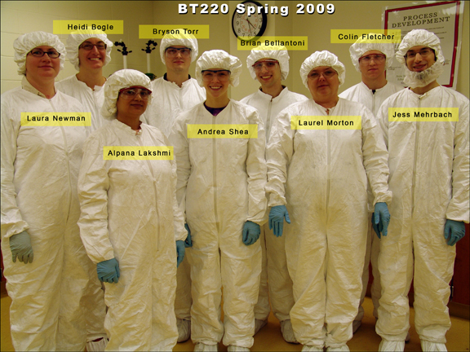
Gowning Certification

Slide 16

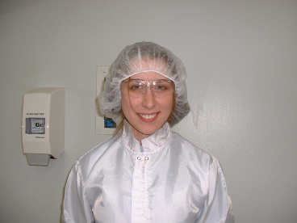
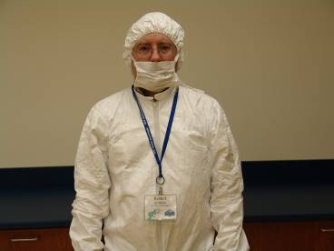
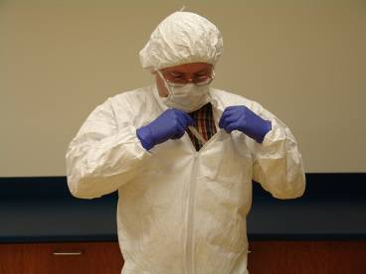
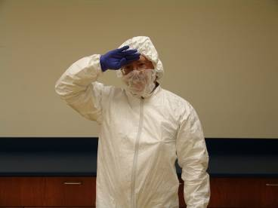
INCORRECT
1
2
3
4

Slide 17
Biopharmaceutical Manufacturing
QC Microbiology
A significant portion of the cGMP regulations pertain to the quality control laboratories including the QC Microbiology Unit which carries out microbiological testing of the product and the microbiological control of site utilities and environment. The principal functions of this unit are: Environmental Monitoring, Microbiological Testing and ID, and the Cell Culture Collection.
Environmental Monitoring = Monitor non-viable and viable contamination (bioburden) throughout the facility using laser particle counter and microbial air sampler.
Microbiological Testing and ID = Gowning certification, air sample processing, production (raw materials, upstream and downstream processing, aseptic fill and finish and storage) and other samples for microbiological contamination (bioburden); ID using Microbial ID System (Biolog, API Strips, PCR, other tests). Use LAL test for endotoxin in WFI water, raw materials and product. Test for mycoplasma in cell cultures (PCR, other tests).
Cell Culture Collection = Testing and release of cell banks.

Slide 18
INCORRECT
1
2
3
4

Slide 19
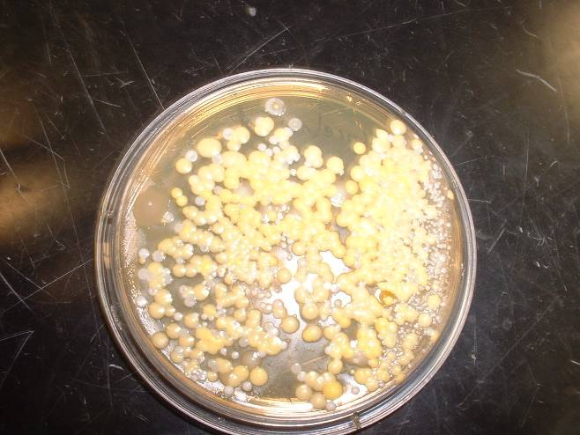
FOREHEAD

Slide 20
ENVIRONMENTAL
MONITORING
“In aseptic processing, one of the most important laboratory controls is the environmental monitoring program”
Guidance for Industry: Sterile Drug Products Produced by Aseptic Processing
Current Good Manufacturing Practice, FDA, September 2004

Slide 21
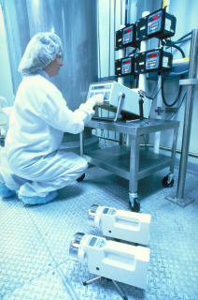
QC Microbiology –
Environmental Monitoring
Laser Particle Counter
Air Samplers

Slide 22
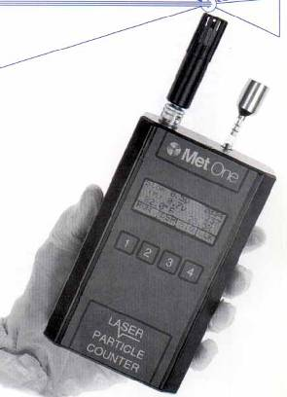
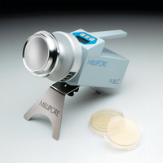
Environmental (Air) Monitoring
Particles
Viable Microbes (Bioburden)
Microbial Air Sampler
Laser Particle Counter

Slide 23
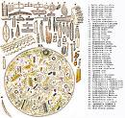
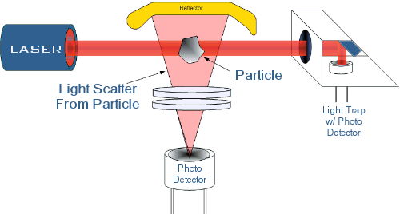
Environmental (Air) Monitoring
Microbial Air Sampler
(colony forming units/
cubic meter)
Laser Particle Counter
(particles/cubic meter)
www.safety-epa.com/history_mold_air_sampling.htm

Slide 24
Utilities Managed by Facilities/Metrology Technicians
Water*: 200,000 to 300,000 liters of water are used per day in a commercial biopharmaceutical manufacturing facility.
WFI: sand, diatomaceous earth, charcoal filter, water softener, RO, uv treatment, distillation, and constant circulate in a loop at 80 C degrees. WFI piped to production equipment for CIP and SIP processes and for making media and buffers for production.
DI and USP water used in QC labs (less pure); chilled potable water used for cooling.
Gasses:
Air, oxygen, and carbon dioxide to keep cells happy, nitrogen, and helium (to check for leaks in equipment).
HVAC: Heating, ventilation, and air conditioning in clean rooms and gray spaces.
Waste*:
Cells (sludge) - heat to very high temperatures and to sewer; liquids (media and buffers) treat with base and acid in a series of (three) tanks until neutral pH and to sewer.
*Piped with 316L stainless dairy piping, triclover clamps, and valves.

Slide 25
Quality Assurance
“If you didn’t document it, you didn’t do it.”

Slide 26

Quality Assurance
21 CFR Parts 210-211 contain the minimum current good manufacturing practice for methods to be used in, and the facilities or controls to be used for, the manufacture, processing, packing, or holding of a drug to assure that such drug meets the requirements of the act as to safety, and has the identity and strength and meets the quality and purity characteristics that it purports or is represented to possess.
http://www.21cfrpart11.com/files/library/pred_rules/mcdowall_gmp_annotate.pdf

Slide 27

BIOMANUFACTURING
DOCUMENTATION
Assures the product reproducibly meets
predetermined specifications
QUALITY
ASSURANCE
APPROVES ALL
DOCUMENTS
and
MAINTAINS
THE FILES
“If you didn’t document it, you didn’t do it.”

Slide 28
TYPES of DOCUMENTS
RAW MATERIAL SPECIFICATIONS
SOPs
MASTER BATCH PRODUCTION RECORDS
PRODUCTION BATCH RECORDS
DEVIATION FORMS
NUMBERING SYSTEM
VALIDATION RECORDS
EQUIPMENT USE and CLEANING LOG BOOKS
COMPONENT, CONTAINER and CLOSURE RECORDS
DISTRIBUTION RECORDS
COMPLAINT FILES

Slide 29
Document
is written
QA assigns a
document
number
Circulated
for
review
Approved and
signed by
QC, QA,
operations,
facilities
Effective date
assigned
allowing for time
to train personnel
QA distributes
to authorized
Personnel.
Obsolete versions
destroyed.
Master copy retained
DOCUMENT BECOMES EFFECTIVE

Slide 30
SOP: Standard Operating Procedure
Purpose
Scope
Responsibilities
References
Definitions
Precautions
Materials/Equipment
Procedure
Attachments
History

Slide 31
Purpose
Describes why the SOP exists.
Scope
Defines to whom and to what the procedure
applies.
Responsibilities
The person or people responsible for performing and updating the SOP.
May also include the person responsible for overseeing the activities of the SOP
References
Documents such as manufacturer manuals
and other SOPs that were consulted to write the SOP and those that should be consulted to
perform the SOP.
Definitions
Describes any words, phrases or abbreviations specific to the SOP
Ex:Do not include pH, it is common terminology

Slide 32
Precautions
Describes any hazards associated with
the procedure or with materials used in performing the procedure
Materials and
Equipment
Any and all materials and/or equipment that are needed to execute the SOP.
Procedure
A step by step description of the
procedure organized into subgroups
Attachments
Lists attachments by name and number. Attachments are all documents that are necessary to perform the SOP. Typically includes diagrams and drawings
History
Origin of document and revisions

