Slide 2
Objectives
To be informed about the process of clinical trials
Understand the FDA regulations guiding the process
Prepare a clinical trials game for students to play

Slide 3
What do you know about Clinical Trials ?
a) vocabulary:
GMP, FDA, IND, CDER, NIH, NDA
b) do you know anyone who went through a
clinical trial?
c) FDA : covers food, drugs, biological
products, medical processes, cosmetics

Slide 4
What Would You Like to Find Out ?
How is a clinical trial carried out?
Who is responsible for conducting these trials ?
Drugs must be effective/safe
Foreign drugs?

Slide 5
Five Basic Components of Clinical Trials for Investigational New Drug
Pre-clinical trials: Animals or Tissue Culture
Phase 1 clinical studies: Small, healthy groups
Phase 2 clinical studies: Larger, sick population
Phase 3 clinical studies: Broad trial with a large
sick population
Phase 4 clinical studies: Retrospective look at
drug after released

Slide 6
History of FDA and CDER
FDA established in 1906 with Pure Food and
Drug Act
- list ingredients in medicine
- examine samples for adulterated food and
drugs
- federal control via interstate commerce
Following information is available at-http://www.fda.gov/cder/about/history/default.htm

Slide 7
CDER Timeline
1906 Food and Drug Act
1938 Food, Drug, and Cosmetic Act
1953: Factory Inspection; manufacturers must provide information about analysis of samples
1962: Thalidomide causes widespread birth defects in other countries. Congress institutes supervision over drug safety
1968 : Drug trafficking is now under the control of the treasury’s
department of narcotics and dangerous drugs

Slide 8













Pre-1906 Sales of Medicines
Brain Centers
Glands Wear Out!
Epilepsy Treatment
Throat and Lung
Consumption Remedy
Certificate of Purity
Energizing Tonic
Lose Weight
Snake Oil
Germ Killer
Renovator
Heart Remedy

Slide 9
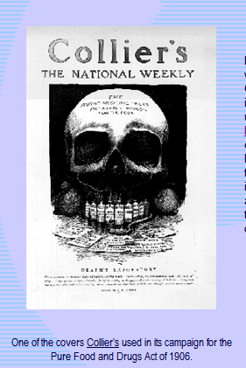
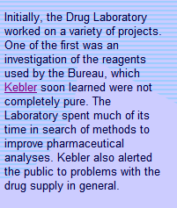
fda/gov/cder/about/history/time.1htm

Slide 10
Elixir Sulfanilamide 1937
Previous Law did not address safety of drugs
This drug was dissolved in diethylene glycol
Over 100 people died, mostly children
Led to a demand for redefining FDA laws

Slide 11
1938 Food, Drug & Cosmetic Act
Drugs must be tested for safety before being marketed
Drug maker must submit a New Drug application to obtain approval to sell drug
This application must include results of
safety regulations
Drugs must have adequate labeling

Slide 12
FDA in the 1940’s
Insulin amendment act: all batches must be
tested for purity, strength, quality and identity
Penicillin must be assigned a strength and
assessment of purity

Slide 13
FDA in the 1950’s
Adverse reaction reported to Chloromycetin
Dycrasia, bleeding, lack of platelets, and white blood cells
Voluntary drug adverse effects reporting to FDA
Big expansion of the FDA to Include 7
different divisions

Slide 14
The Thalidomide Story
Drug approved for sleep and nausea in
Europe and Canada
Dr. Francis Kelsey was awarded medal of honor
Was submitted to the FDA but not approved as a new drug application:
Insufficient safety data
Was not approved for marketing

Slide 15
1962 Drug Amendments
Drugs must both be safe and effective prior to
being marketed
Antibiotics must be certified
FDA was given control over marketing of drugs

Slide 16
Popular Influence on FDA Procedures
Coalition of activists for Aids cure was formed
1987
Sought to expand and expedite new treatments
Orphan drug act instituted 1983
Anti-tampering act 1982

Slide 17
Further Expansion of FDA 1987
Center for Drugs /Biologics was split into
Several Separate Units
Center for Drug Evaluattion and Research
Center for Biologic Evaluation and Research

Slide 18
Hatch/Waxman Amendments 1984
50% of all prescription drugs are generic with cost 50$ less per prescription than name brand
2000 : 44% of drugs are filled with generic varieties
Generic drug makers can rely on previous safety & efficacious findings of original drug application
Same application as for NDA but is amended
NDA

Slide 19
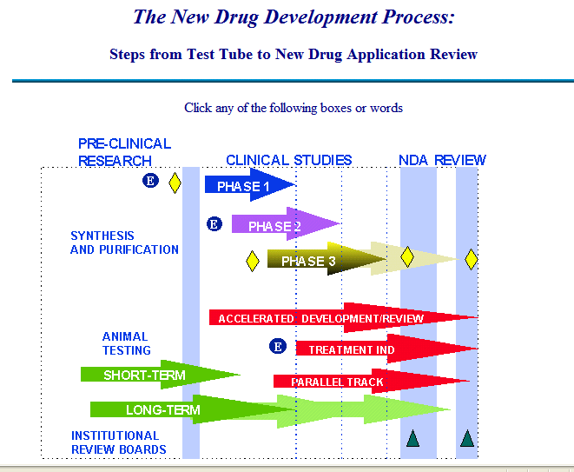
FDA.gov/cder/handbook/develop. htm

Slide 20
Pre-Clinical Trials
Based on fundamental scientific findings
Consists of short-term testing in animals using the compound of interest
Usually takes from 2 weeks to 3 months
Tests toxicity, absorption, clearance of drug
compound must be biologically safe for initial administration to humans

Slide 21
Clinical Trials
Pre-Investigational New Drug (IND)
NDA = new drug application
Two trial types: observational & interventional
Discussion begins about testing phases
Including data requirements
Scientific issues
Required for further testing:
Compound must be biologically active
Compound must be safe for data shown

Slide 22
What Drugs Make it to Clinical Trials?
Synthesis and Purification of Product
1/1000 are successful
Up to 8 ½ years to go through trials
Drug selection is made by using test models for a disease/adding drug to determine its effect
Selection by screening – microorganisms/plants
Other forces, price, marketing etc.

Slide 23
Institutional Review Boards (IRB)‏
Ensures rights for public participation
Patient must be fully informed
Written consent obtained before trial
Consists of 5 experts + lay people
Must understand specific drug action, law, constitutional involvement

Slide 24
Phase 1 Clinical Studies of IND
Drugs used in humans
Subjects are usually healthy volunteers
Double blind studies
Is subject to a clinical hold, 483 warning is issued
Monitors the following:
Toxicity
Drug metabolism
Mechanism of action

Slide 25
Phase 2 Clinical Studies of IND
Obtain preliminary data about effectiveness of the drug
Determines the common short term side effects
Risks associated with drug
Well controlled, closely monitored
Usually 100 hundred carefully selected people

Slide 26
Controlled Trials
Designed to permit valid comparisons with a placebo
Dose response curve is created
Control is concurrent with tested substance
Comparison can be made to earlier studies
Sometimes there is no control: Requires special approach
Multiple resistant pathogens
Example extremely drug resistant TB (XDR TB)‏

Slide 27
Phase 3 Clinical Trials
Expanded controlled trials
Measures effectiveness and safety of drug
Includes hundreds-thousands of patients
Evaluates risk/benefit for majority of people
Requires statistical analysis

Slide 28
Phase 4 Clinical Trial
A retrospective view of overall effects of drug on a large population over time
Statistical analysis of effects of preventative or palliative drugs on overall health of individual
Example : Framingham Nurses Health Study

Slide 29
Women’s Health Initiative 15 year analysis of 161,000 women 50-79 years of age
Benefits
57% reduction in colon cancer
Better bone density
Relieves symptoms of menopause
Improves HDL cholesterol levels
Risks
24% increase in breast cancer
24% increase in heart disease (stroke, clots)‏
Increased level of dementia
Statistically insignificant
increase in heart attacks
http://www.whi.org/findings/ht/eplusp_pad.php

Slide 30
Epidemiologic Studies
Unknown factors might be driving results
(statistics can be misleading)‏
Is not as significant as a blind study with controlled groups
Contradicts other evidence about heart disease

Slide 31
Gene Therapy
How does one carry out clinical trials for gene
therapy ?
Jessie Gelsinger had genetic disorder (OTC)‏
Ornithine transcarbamylase
Died within days of being injected with
a healthy gene attached to an adenovirus
September 17,1999

Slide 32
Reforms Instituted
Clear, pertinent information about toxic effects seen in animal trials at U Penn was not disclosed
Many other studies were discovered that had
withheld adverse effects from reports to FDA
The FDA withheld adverse effects from patient
All gene therapy trials were suspended in the US

Slide 33
Conflict of Interest ?
Paul Gelsinger said that regulators are aiming in the wrong direction if they don’t correct the undue influence of business interests on gene therapy research.
Business argued that they need to keep adverse effects under wraps due to competition and
and fear of frightening the public

Slide 34
Exploring the FDA website
www.fda.gov/cder/about/default.htm
Go to section on CDER that is titled
What do we do?
Go to MAPP [ Manual of Policy and Procedures]
Office of drug safety Chapter 6000
Review Management 6010.1

Slide 35
6010.1 New Drug Application
Pre-approval Safety Conference: insures communication before approval alerts everyone to potential problems
How frequent would an adverse drug reaction have to be to gain notice?
What must the project manager do to review a new chemical entity or drug?

Slide 36
Let’s Make Our Game
Choose a game which most like to play
Monopoly
Shoots and Ladders
Clue
Make up rules that require all three phases of
Design a board that will allow players to travel around the board to obtain approval for all 3 phases of Trials
Create cards to be drawn determine how to use dice to allow players to move

Slide 37
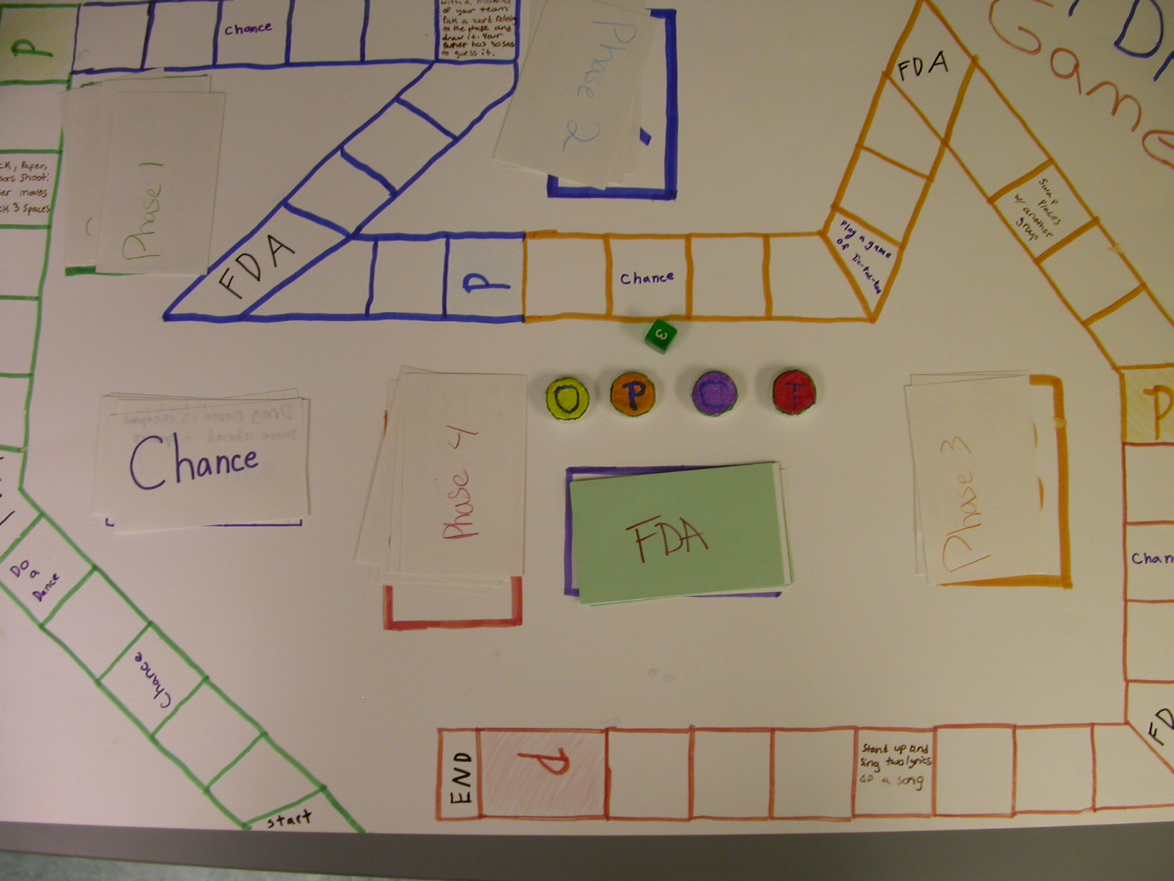
FDA Drug Approval Game

