Slide 1


Slide 2
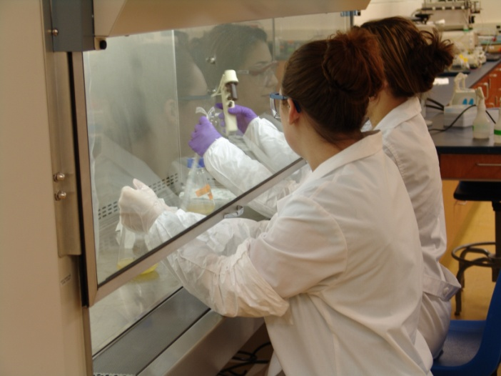
Discovery Research and Cell Culture

Slide 3
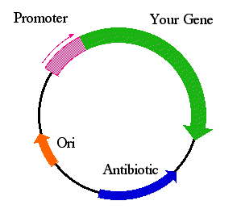
The Expression Vector:
The Basis of Biotechnology Manufacturing
Notes:
www.bio.davidson.edu/.../plasmid_inducible.html

Slide 4
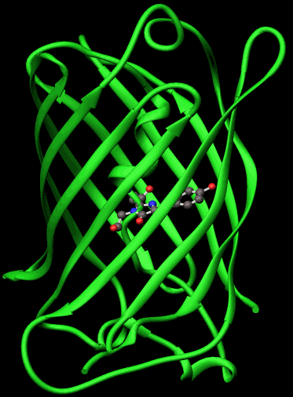
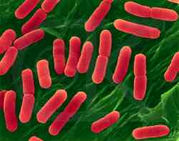
Escherichia coli – GFP
Escherichia coli
Green Fluorescent Protein

Slide 5
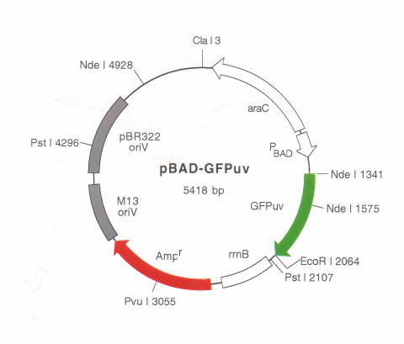
GFP Expression Vector

Slide 6
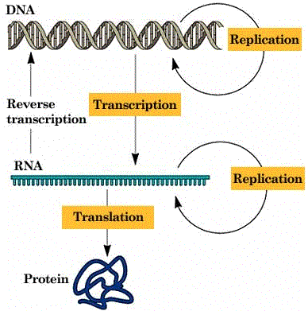
Central Dogma of Biology
Notes:
faculty.uca.edu/~johnc/rnaprot1440.htm

Slide 7
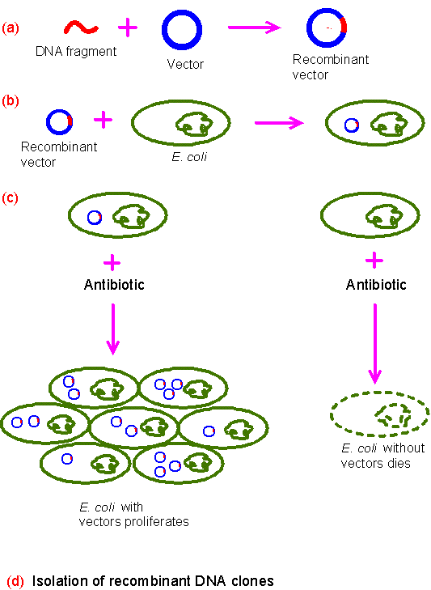
Transformation and Cloning
Notes:
www.kensbiorefs.com/MolecularGen.html

Slide 8
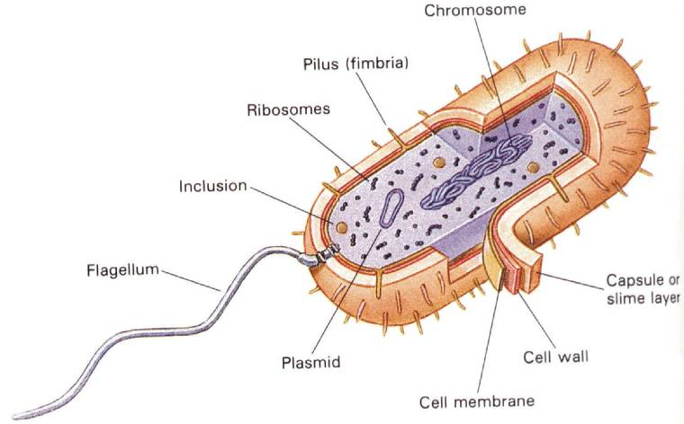
Escherichia coli

Slide 9
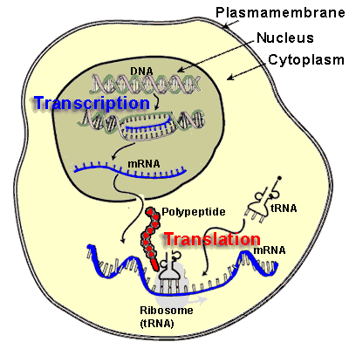
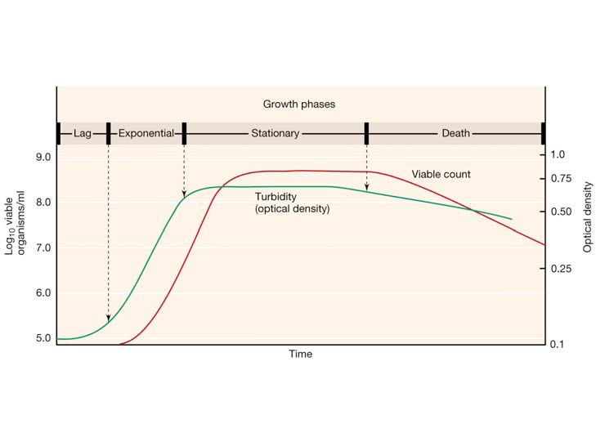
Two Stages to Production – Both Require ATP
Synthesis Protein of Interest
Cell Growth and Reproduction

Slide 10
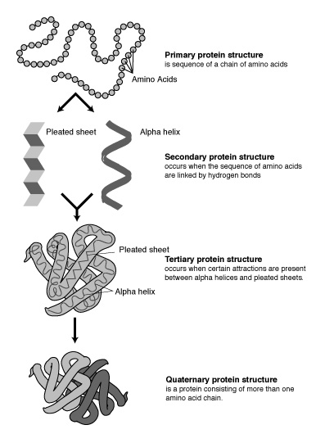
Four Levels of Organization of Protein Structure

Slide 11
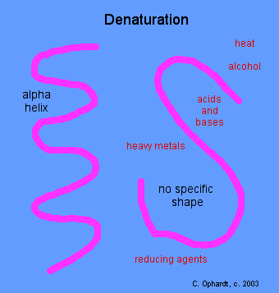
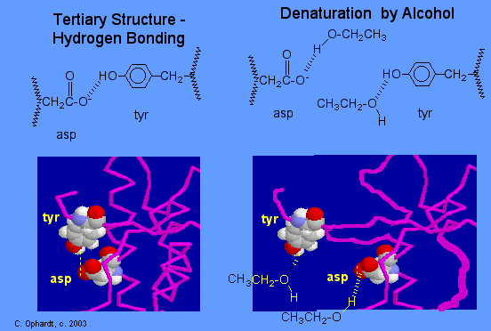
Denaturation

Slide 12
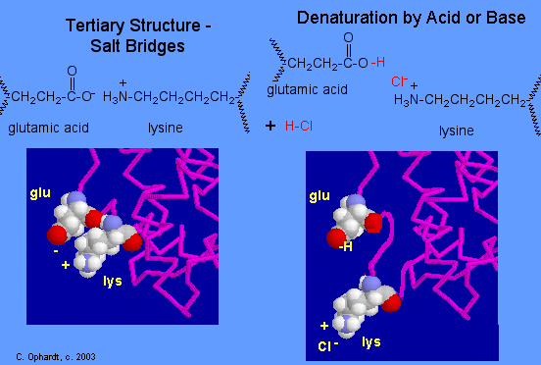
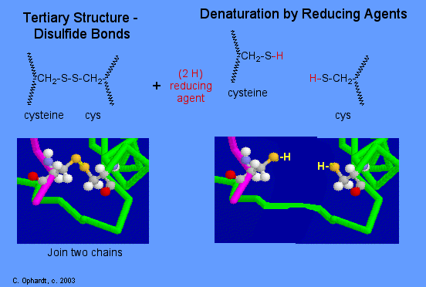
Denaturation

Slide 13
Proteins are the Machines and form the Structure of Life
Proteins are used by the body for a whole host of things, e.g. within blood (for carrying molecules and for clotting), for digestion (enzymes are proteins), for movement (actin and myosin in muscle), etc. One other major role of proteins is that of "structural proteins", i.e. those proteins that contribute to and sustain the integrity of the human structure. Collagen is a structural protein.

Slide 14
Proteins
Hormones like human growth hormone and insulin
Enzymes like lipase and protease
Receptors for neurotransmitters, hormones, and transferrin
Signal transduction proteins (produce cascades)
Carrier proteins (for HDL, LDL, and iron)
Membrane proteins (ion chanels)
Immunoglobulins (antibodies)
Blood Proteins: albumin, transferrin, factor VIII
DNA Transcription Factors
Actin and myosin
Hemoglobin
Structural proteins like collagen, elastin, spectrin
Notes:
matcmadison.edu/.../labManual/chapter_2.htm

Slide 15
Animation of Signal Transduction Pathway involving Multiple Proteins
http://www.learner.org/courses/biology/archive/animations/hires/a_cancer1_h.html

Slide 16
Best Site for PROTEIN Research
www.drugbank.ca

Slide 17
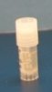
Typical Production Process Flow
Ampule Thaw
Inoculum Expansion
(Spinner Bottles)
(Feed1)
(Feed 2)
Centrifuge
(Feed 3)
(Feed 4)
Concentration /
Diafiltration
Chrom 3
Chrom 2
Chrom 1
Viral Removal Filtration
Cryo-preservation

Slide 18
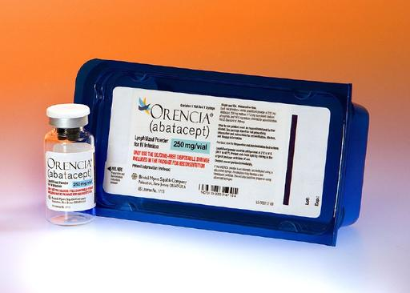
Upstream/Downstream Manufacturing Overview
Large Scale Bioreactor
1 day
Media Prep
Working Cell
Bank
Seed Bioreactors
26,000L Bioreactor
Centrifuge
5,000L Bioreactor
750L Bioreactor
150L Bioreactor
Depth
Filtration
Sub-
Culture
Sub-
Culture
Sub-
Culture
Sub-
Culture
Sub-
Culture
Wave
Bag
Collection
Inoculum
Fermentation
Harvest/Recovery
24 days
31 days
Eluate
Hold
Tank
20,000L
Viral Inactivation
Eluate
Hold
Tank
20,000L
Eluate
Hold
Tank
8,000L
Filter
Column
Column
Harvest
Collection
Tank
1,500L
Chromatography Skid
Chromatography Skid
Anion Exchange Chromatography (QXL)
Hydrophobic Interaction Chromatography (HIC)
Purification
Filter
Column
Eluate
Hold
Tank
6,000L
Filter
Column
Chromatography Skid
Post-viral
Hold
Vessel
3,000L
Chromatography Skid
Eluate
Hold
Tank
5,000L
Protein A Chromatography
Viral Filtering
Anion Exchange Chromatography (QFF - Fast Flow)
Ultra Filtration
Diafiltration
Bulk Fill
8 days

Slide 19
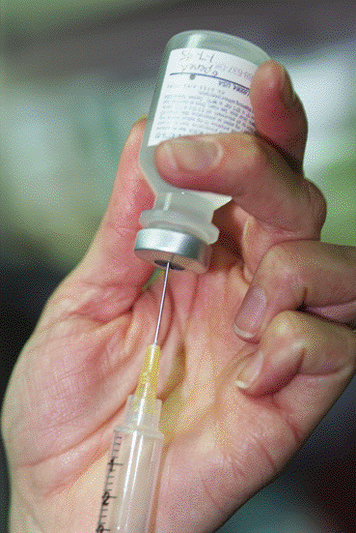
Biopharmaceutical Proteins are Parenteral

Slide 20
Use Aseptic Technique in Clean Rooms
Shake Flask Inoculation using BSC Class 100 (5)

Slide 21
Media Preparation for Cell Growth and Protein Expression
Feeding Doubling of Cells and Synthesis of Protein

Slide 22
Media and Feeds Support each Stage
E. coli media requires some chemicals and non-defined components (hydrolyzed protein and yeast extract) to grow a batch and an inducer to produce the protein of interest. This is the cheapest medium.
CHO cells require complex medium containing all 20 amino acids, fatty acids, and carbohydrates. Growth media requires 10% fetal bovine serum (FBS) but can be weaned to a serum-free medium. Most expensive medium.
Pichia pastoris requires chemicals and non-defined components (hydrolyzed protein, yeast extract and yeast nitrogen base) to grow a fed-batch and an inducer (methanol) to express large quantities of the protein of interest.

Slide 23

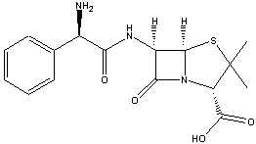
Escherichia coli (Prokaryot)Media
LB Broth with Arabinose
NaCl
Yeast Extract
Tryptone or Peptone
Arabinose – The Inducer

Slide 24
Yeast Extract
The main components of yeast extract are:
  total nitrogen content : 8 to 12 %, corresponding to a protein content of 50 to 75 %
  amino nitrogen content : 3.0 to 5.2 %
  total carbohydrate content : 4 to 13 %
  lipid content : none or very little.
Click here to see how yeast extract is made:
http://www.eurasyp.org/public.levure.extrait.screen

Slide 25
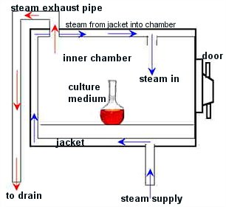
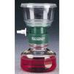

Sterilizing Media/Solutions
Goal: To remove microbial contamination (bioburden)
Autoclave
Sterile Filtration (.22u pores remove bacteria)

Slide 26
Sterilization by Filtration at .22u
Normal Flow Filtration : (NFF)
Normal Flow (NFF)
Build up of retained components on filter surface and within filter matrix.
NFF is robust and easy-to-use

Slide 27

Spinner Flasks
Placed in a CO₂ incubator to provide a controlled environment for CHO cell scale-up
Temperature: 37ºC
CO₂: 5%
pH: 7.2
Agitation via Magnetic Stir Plate: 75 rpm

Slide 28
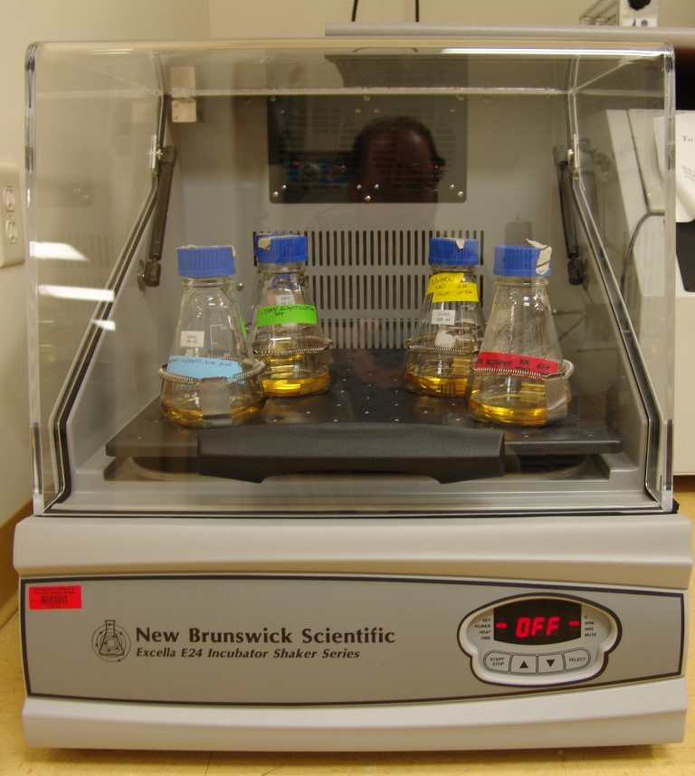
Shake Flasks in Shaking Incubator

Slide 29
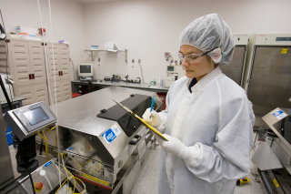
A disposable WAVE bioreactor

Slide 30
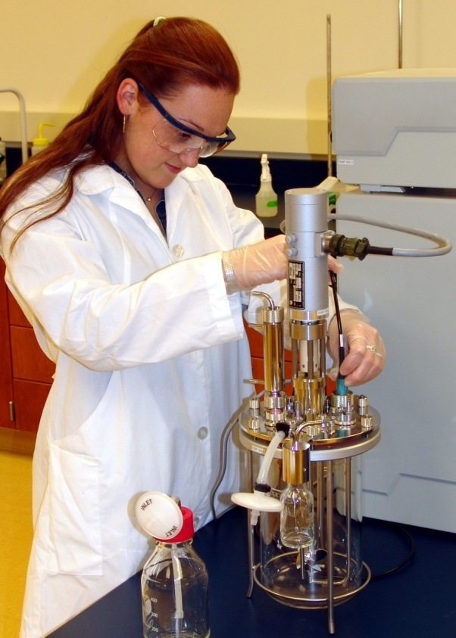
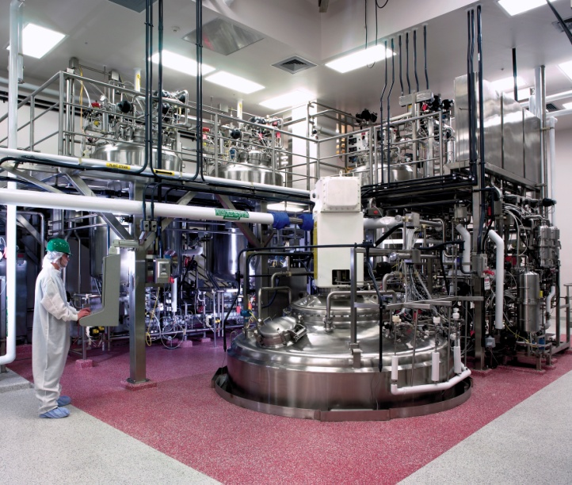
Upstream Processing Equipment
Lab-Scale Bioreactor
3 liters
Large-Scale Bioreactor
25,000 liters

Slide 31
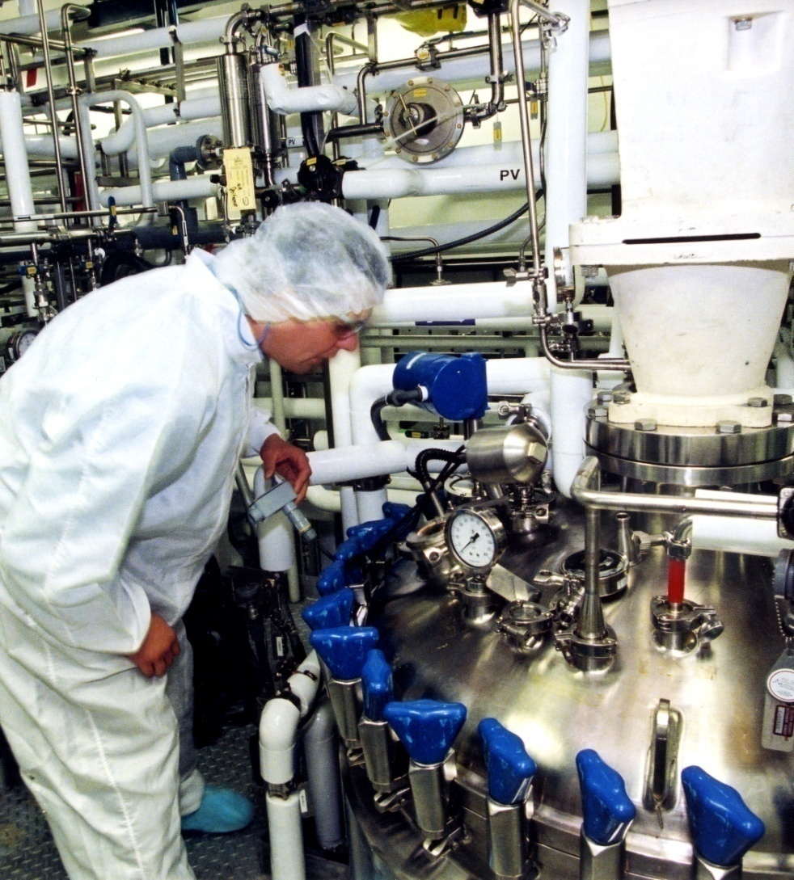
Types of Bioreactors
The Top of a 20,000 liter Commercial-Scale Bioreactor
(Process-Controlled)

Slide 32
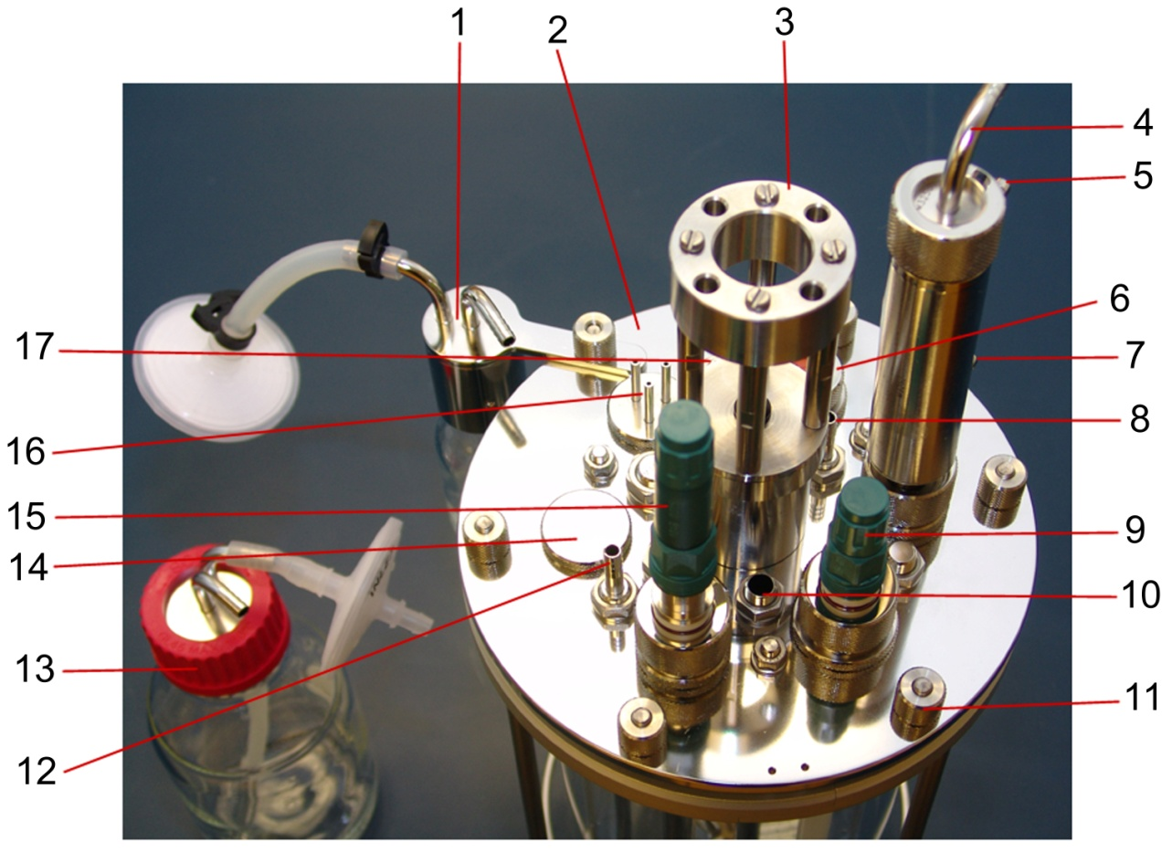
Topside Head plate
1. Sample bottle assembly
2. Head plate assembly
3. Stirrer motor mount
4. Condenser air outlet
5. Condenser water outlet (from)
6. Inoculation port
7. Condenser water inlet (to)
8. CO₂ overlay port
9. pH probe
10. Thermowell port
11. Mill fastener
12. Sparger
13. Feed bottle
14. Blind stopper
15. DO probe
16. 3 Feed ports
17. Harvest tube

Slide 33
Monitoring Growth
The importance – The growth rate (u) and doubling time (T_{d}) help to determine when to feed, when to harvest and such.
The assays for cell growth and reproduction – live cell counts, optical density (OD) readings, and WCW measurements give you the data needed to determine the growth rate and doubling time.

Slide 34
Growth Rate and Doubling Time
Calculations
Growth Rate
u = (lnOD₂-lnOD₁)/T₂-T₁
_{Or}
u = (lnX₂ – lnX₁)/T₂-T₁ (where X=live cell count)
Doubling Time
T_{d} = ln2/u

Slide 35
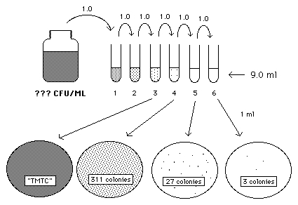
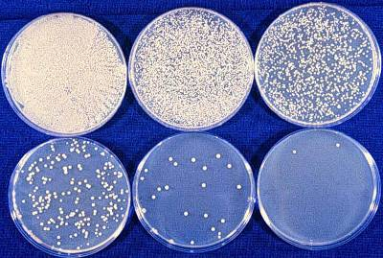
Live Cell Count: Spread Plate Method

Slide 36
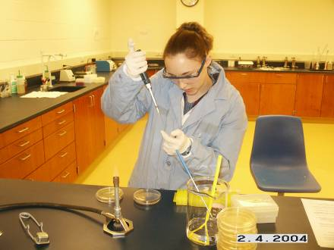
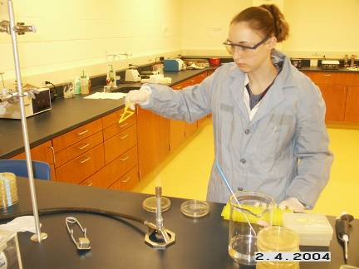
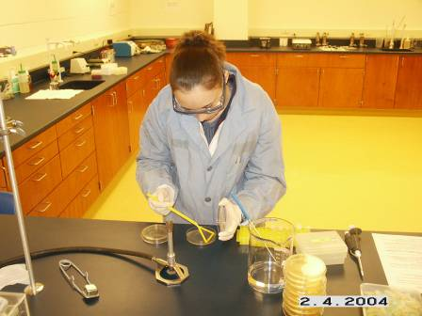
Carefully prepared spread plates for viable cell counts
Prepare serial dilutions and pipet onto the agar plate
Flame sterilize the spreader
Spread the cells onto the agar plate

Slide 37
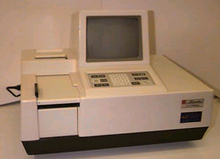
Optical Density (OD) Measurements using a Spectrophotometer

Slide 38
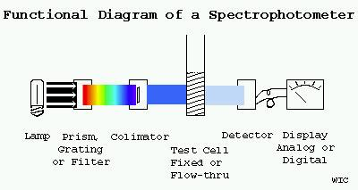
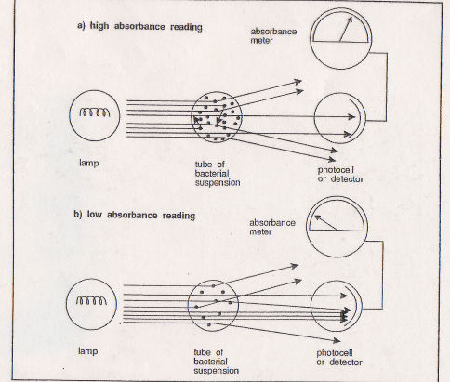
Spectrophometers measure Optical Density. Knowing the OD or, one can determine the growth rate (u) and from the growth rate, the doubling time (T_{d}) of the fed-batch culture can be determined.

Slide 39
Monitoring The Product (Protein)
A uv-visible spectrophometer may be set at 280nm to determine the concentration of protein in the media.

Slide 40
Monitoring Growth Conditions
pH – Often drops as cells grow and divide, if the culture doesn’t get enough oxygen so that glucose is broken down by glycolysis into lactic acid which crosses the cell membrane enters the media and creates an acid environment. If there is plenty of oxygen, glucose is broken down into pyruvic acid which enters the mitochondria producing H₂0, CO₂, and energy (ATP and heat).
Analyate analysis - Glucose concentration measurements using an analyate analyzer such as a Biolyzer or a Nova, allows us to determine when glucose has been used up and therefore when to start feeding methanol for protein production or to determine when lactate is being produced, a sign of anerobic respiration
Temperature – Each cell type needs different temperature; Pichia pastoris require 30 degrees C.
Dissolved Oxygen – Oxygen is needed to accept protons from the NADH hydrogen atoms in the mitochondrial electron transport chain.

Slide 41
Process Control
Head Plate
  Stirrer motor mount (motor controls the agitation rate)
  Condenser (outlet)
  Inoculation port (pump seed reactor contents here)
  pH probe (measures pH of media; negative feedback loop adds acid or base)
  Thermo well port (put temperature probe in here to measure temperature; negative feedback loop cools or heats)
  Sparger (bubbles gasses into media)
  Feed bottle (to add glucose, acid or base, methanol)
  DO probe (measures dissolved oxygen in the media; negative feedback loops control agitation, air and oxygen)
  Harvest port (for harvesting batch)
  Impeller (like a propeller – moves fluid and propelled by motor)
Computer Controller

Slide 42
Parameters Monitored
(most Process-Control via feedback loops)
pH (via addition of base or acid)
Temperature (via jackets that heat or cool)
Oxygen (via sparging air or oxygen and agitation)
Rate of Agitation (via need for air or oxygen)
Carbon Dioxide (via sparging)
Feed (via addition of appropriate nutrients)
OD (via spectrophotometer)

Slide 43
Characteristics of Microbial and Mammalian Cell Culture
Parameter | Microbial Cell Culture | Mammalian Cell Culture
Growth Rate (u) | Doubling Time = minutes to hours | Doubling Time = days
Temperature (T) | Great diversity: -0 to +100 degrees (plus/minus 1) C often by cooling | Most: 37 to 42 degrees C Control to plus or minus .1 degree C
pH | Great diversity: pH 2-10 (Pichia = pH 5.8) Control by adding acid or base | Narrow range: pH 6.8 to 7.2 (CHO = pH 7.2) Control by sparging CO²
Dissolved Oxygen (DO) | Air or Oxygen sparged Robust cell walls allow rigorous sparging | Air sparged Extremely shear sensitive use sintered sparger
Agitation Rate | Agitation rates can be >800rpm Use Rushton impeller | Agitation rates <150rpm Use maine impeller
Foam | Foam probe, anti-foam agent required | No foam probe or anti-foam required

Slide 44
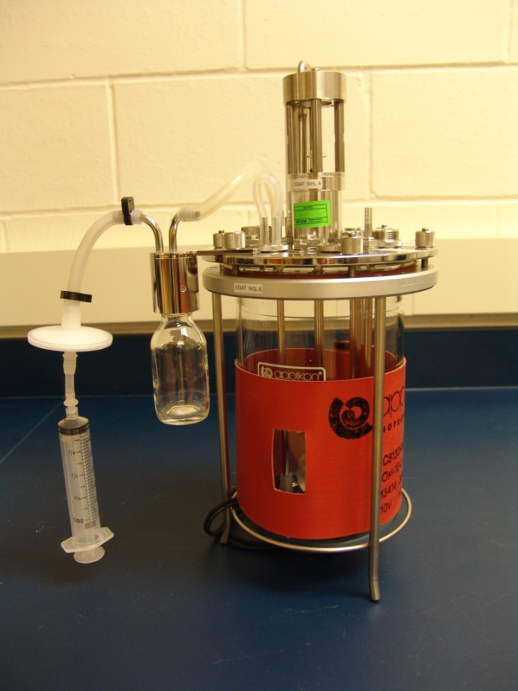
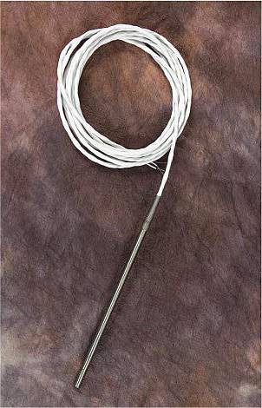
Temperature Control for Mammalian Cell Culture
  For mammalian cell culture heating is more critical than
  cooling due to slow metabolic rates (doubling time) .
Temperature Probe
Heating Blanket on single wall vessel

Slide 45
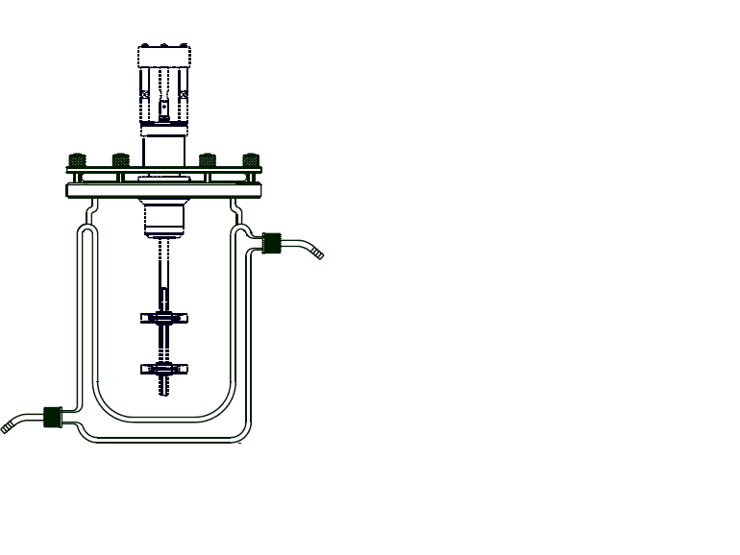
Jacketed Vessel for Heating or Cooling
HEATING
  City water
  Heater with recirculation loop
  Used to heat bioreactors for mammalian cell culture at 37 degrees Centigrade
COOLING
  City water
  Chiller with recirculation loop
  Used to cool fermenters for microbial cell culture, e.g. Pichia pastoris or Escherichia coli

Slide 46
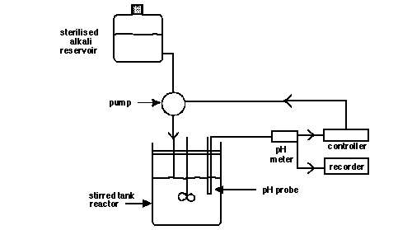
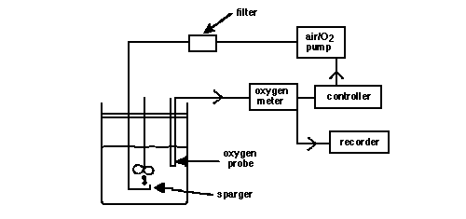
Process-Control Loops
pH Process-Control Loop
DO Process-Control Loop

Slide 47
PID Control
No Control
PID Control

