Slide 1
What is NBC2 ?

Slide 2
Northeast Biomanufacturing Center and Collaborative
NBC2 is a National Science Foundation Advanced Technology Education Center of Excellence
Our Mission: to coordinate local and regional efforts into a national biomanufacturing education and training system to promote, create, and sustain a qualified workforce.
Biomanufacturing.org

Slide 3

Northeast Biomanufacturing Center and Collaborative
Goals for 2016-2019:
Build and foster local partnerships between industry, educational institutions and government
Provide professional development opportunities for CC and HS faculty and students – PiC, BIOMAN, Bootcamp
Develop curricular materials: textbook, lab manuals, SOPs
Disseminate information on biomanufacturing: career opportunities and curricular materials via workshops and website biomanufacturing.org
5. Plan for sustainability of NBC2 and programs

Slide 4
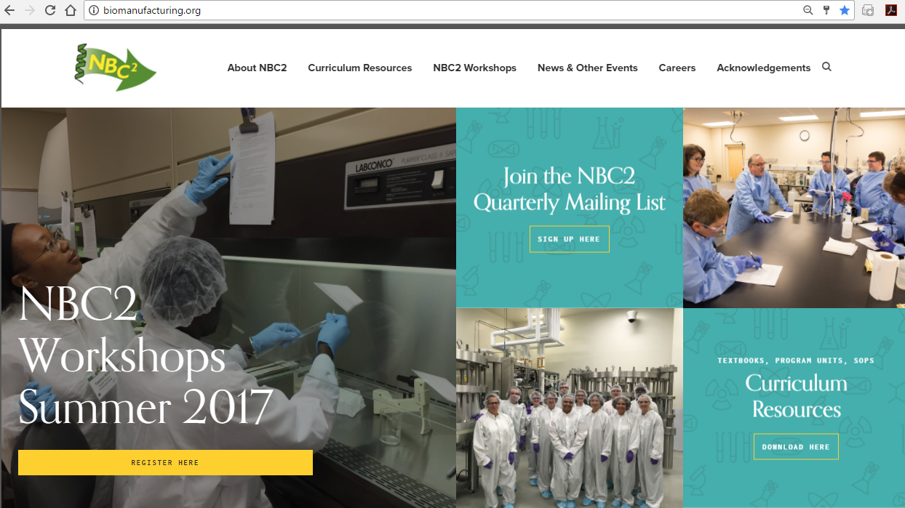
Website
www.biomanufacturing.org

Slide 5
NBC2 Team
Maggie Bryans, PI, MCCC
Linda Rehfuss, Co-PI and co-Lead, Bucks
Matt Marshall, Program Manager at MCCC
Cianna Cooper, Program Manager at Bucks
Co-PIs at 4 NBC2 Hub Schools:
Jim Hewlett, Finger Lakes CC
Sengyong Lee, Ivy Tech CC
Mike Fino, Miracosta CC
Bill Woodruff, Alamance CC

Slide 6
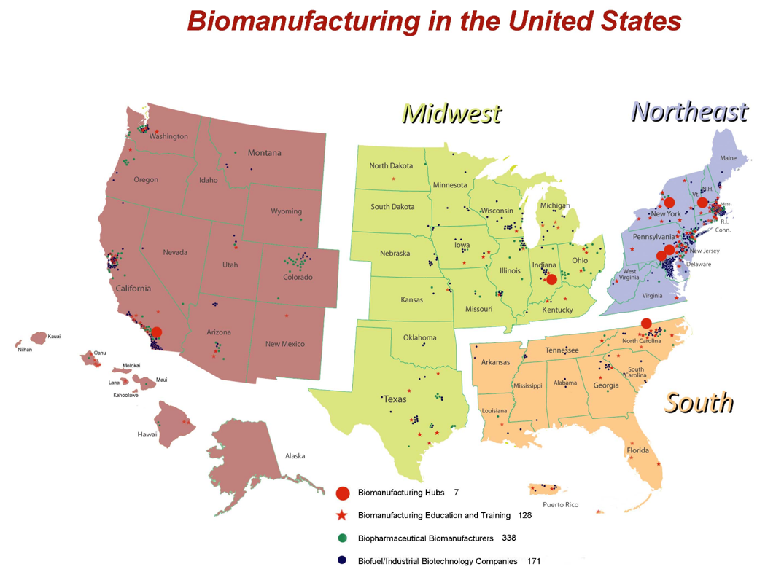
National Regional Hubs
BigPharma Hub
Montgomery County Community College, Blue Bell, PA
Dr. Maggie Bryans
Bucks County Community College, Newtown PA
Dr. Linda Rehfuss
Upstate New York Hub
Finger Lakes Community College, Canandaigua, NY
Dr. Jim Hewlett
Mid-Western Hub
Ivy Tech Community College, Bloomington, IN
Dr. Sengyong Lee
Western Hub
MiraCosta College, Oceanside, CA
Dr. Mike Fino
Southern Hub
Alamance CC, Graham, NC
Dr. Bill Woodruff

Slide 7
Global Biomanufacturing Curriculum Textbook and Laboratory Manuals
* Introduction to Biomanufacturing (textbook), December 2012
* Biomanufacturing Laboratory Manual, July 2009
* Escherichia coli – GFP Core Production System
* CHO – tPA Core Production System
* Pichia pastoris – HSA Core Production System
* Protein is Cash Laboratory Manual, 2017
* Standard Operating Procedures & Batch Records for all laboratory exercises
Biomanufacturing Laboratory Manual (custom)
Great Bay Community, Mount Wachusetts Community College and MCCC
* Free to download at biomanufacturing.org
Notes:
This is the list of what we ‘own’ (published in Phase I or II). And here are copies of each one of these publications (distribute copies printed in Portsmouth). We will talk further about these when we get to Goal 5: Sustainability.

Slide 8
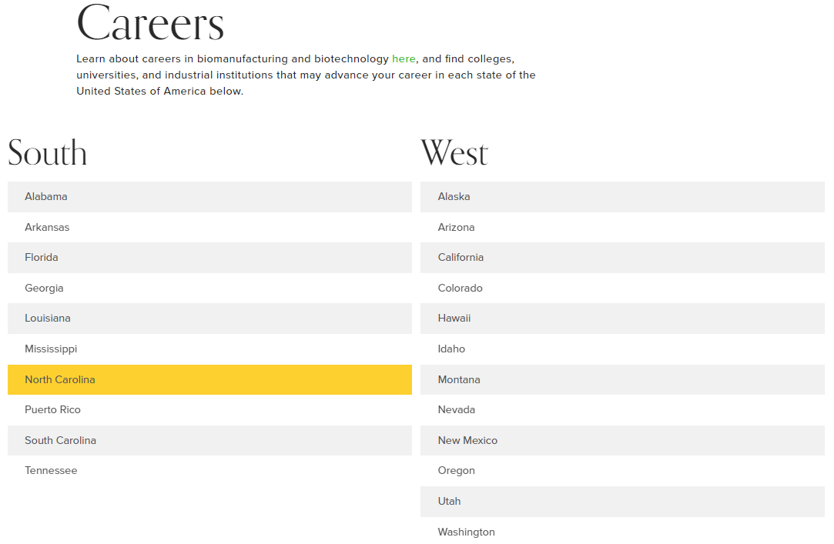
Biomanufacturing.org/careers
Find Biomanufacturing Education
and Career Opportunities in your State / Region

Slide 9
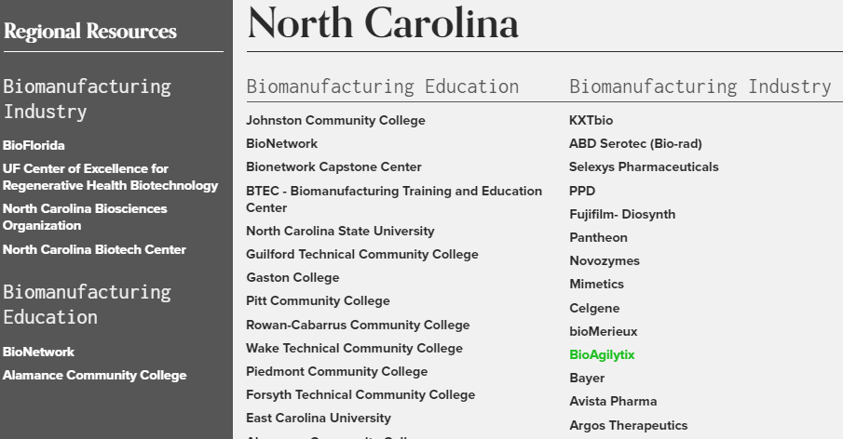
Biomanufacturing.org/careers
Find Biomanufacturing Education
and Career Opportunities in your State / Region

Slide 10
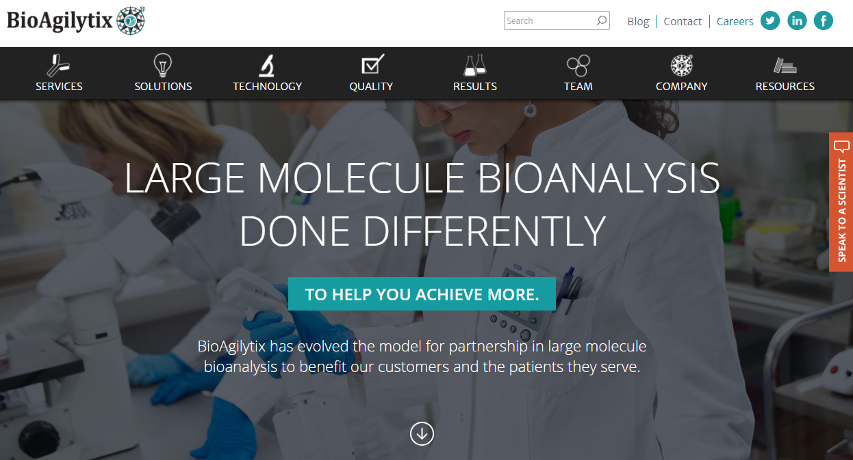
Biomanufacturing.org/careers
Find Biomanufacturing Education
and Career Opportunities in your State / Region

Slide 11
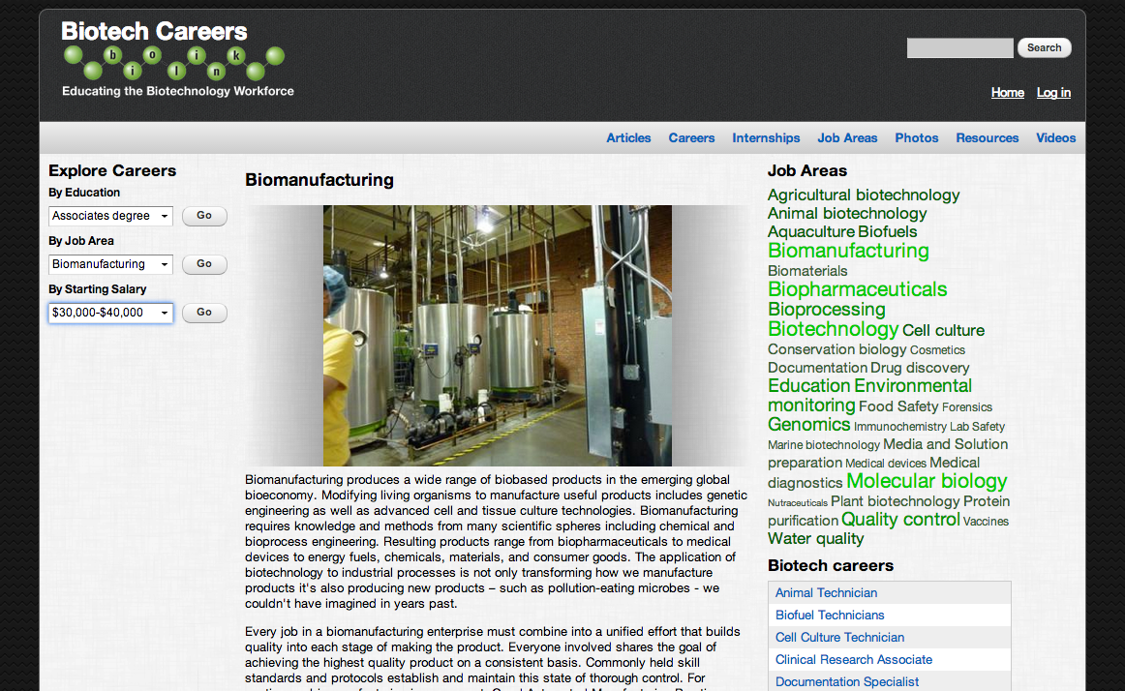
Find Links to other Biotech & Biomanufacturing Online Resources e.g. Bio-Link

Slide 12
NBC2
Faces of Success

Slide 13
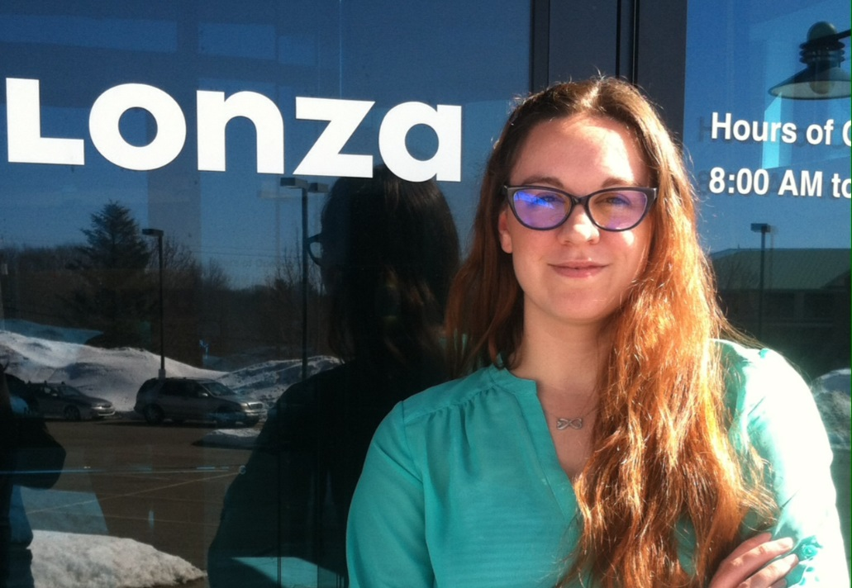
Katrice Jalbert Job Title: Deviation Writer Level II Company: Lonza Biopharmaceuticals
Education Pathway:
H.S. Degree in Biotechnology
Associates Degree in Biotechnology & Biomanufacturing at Great Bay Community College, Portsmouth, NH
Apprenticeship with Lonza Biopharmaceuticals led to her hiring

Slide 14
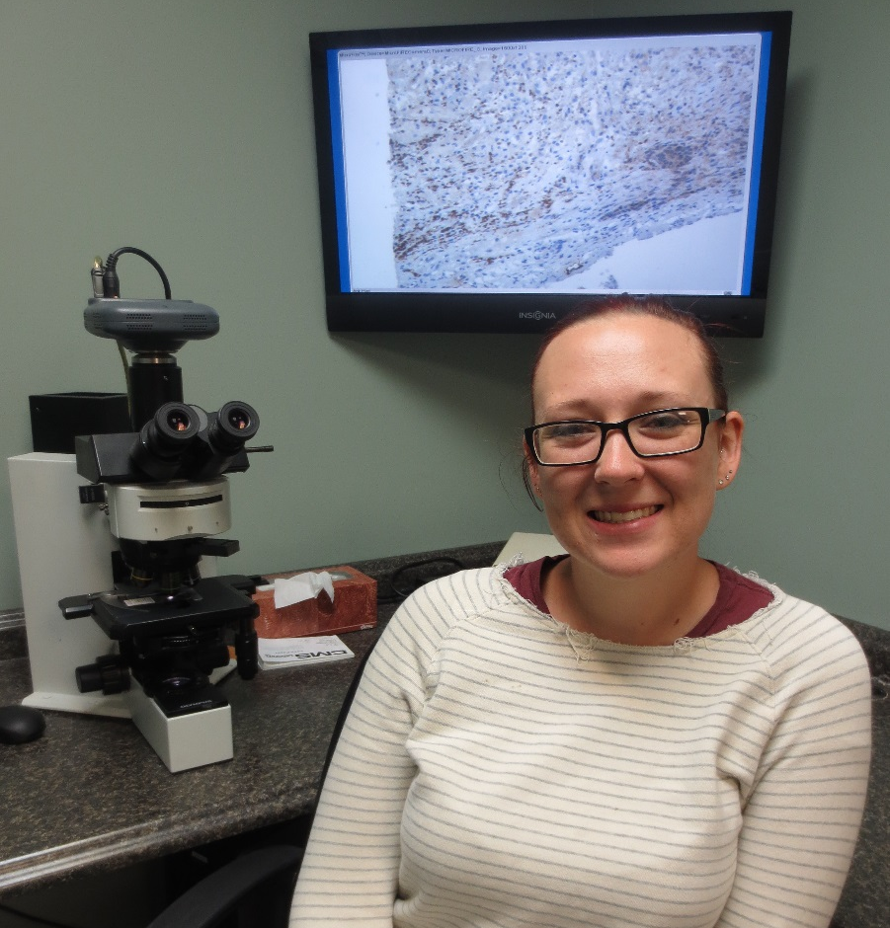
Liz Neuman Job Title: Research Assistant Company: Qualtek Molecular Laboratories
Education Pathway:
Associates Degree in Biotechnology & Biomanufacturing at MCCC in Blue Bell, PA
Bachelor’s Degree in Microbiology and Biotechnology at Delaware Valley College

Slide 15
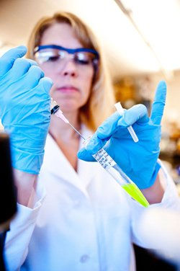
Karin Klauder Job Title: Quality Control Chemist Company: GEO Specialty Chemicals
Education Pathway:
Associates Degree in Biotechnology & Biomanufacturing at MCCC in Blue Bell, PA

Slide 16
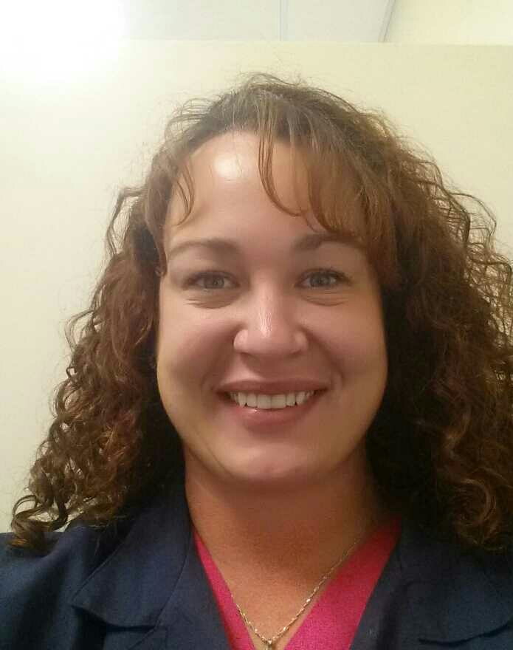
Kristine Lewis Job Title: Quality Control Analytical Chemistry Stability Assistant Company: Cook Pharmica LLC
Education Pathway:
Associates in Biotechnology from Ivy Tech Community College Bloomington
Bachelor’s in Biotechnology from Indiana University
Master’s in Biotechnology and Regulatory Affairs online program at John Hopkins University,

Slide 17
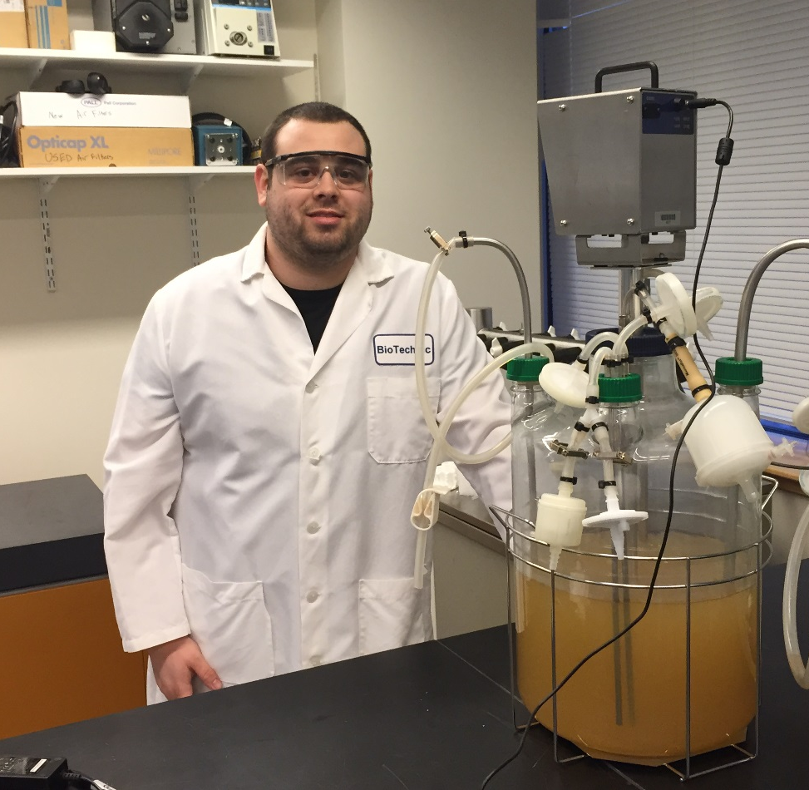
Kevin Brown Job Title: Research Associate Company: Biotechnic Products LTD
Education Pathway:
Biotechnology Academy High School Program
Biomanufacturing certificate at MWCC
Internship at Biotechnic Products LTD

Slide 18
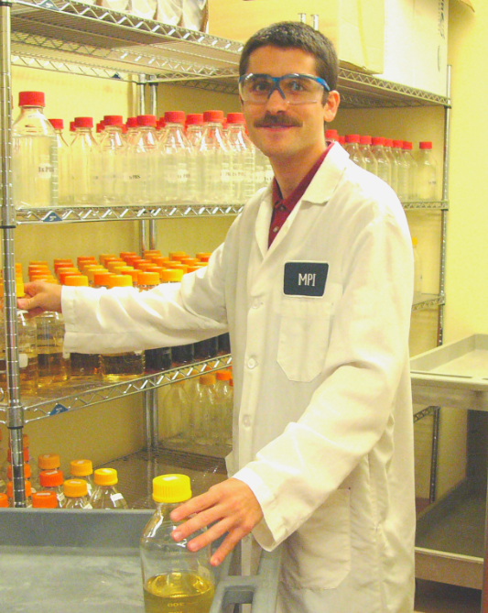
David Haddadd Job Title: Lab Assistant Company: Millennium (Takeda)
Education Pathway:
High School Biotechnology
Associates in Biotechnology and Biomanufacturing at NHCTC
Apprenticeship at Millennuim
Bachelor’s Degree at Harvard
Master’s Degree in Biotechnology at Harvard

Slide 19
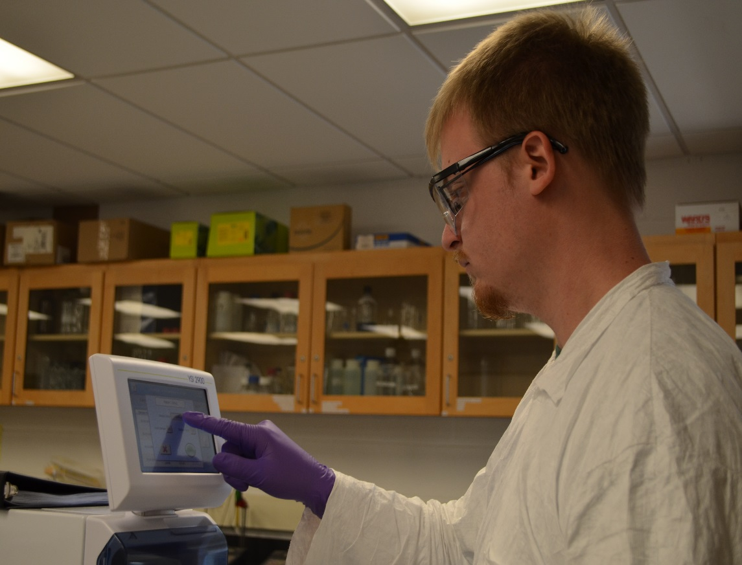
Rick Wollover Job Title: QC Associate Company: KVK-Tech
Education Pathway:
Associates in Biotechnology at Bucks County Community College

Slide 20
NBC2
Protein is Ca$h HS Teacher Workshop

Slide 21
Protein is Cash HS teacher workshop
Central Dogma: DNA RNA Protein
Discovery Research (DNA Centric)
Process Development and Biomanufacturing (Protein Centric)
DNA is the FLASH, Protein is the CA$H!!!!

Slide 22
Protein is Cash HS teacher workshop
Protein is Ca$h
Agenda:
DAY 1: Metrology – pipette performance verification
DAY 2: Upstream Processing – bacterial transformation/scale up
DAY 3: Downstream Processing – column chromatography
DAY 4: Quality Control Biochemistry – SDS PAGE
DAY 5: Biofuels – crossover industry
Goals: to increase knowledge of -
the Biopharmaceutical Industry
types of jobs and career pathways available
how to introduce the main concepts of the industry into your high school lab.

Slide 23

Protein is Cash teacher support website:
Protein is Cash laboratory manual with Standard Operating Procedures (SOPs) for each experiment.
Navigate to: Biomanufacturing.org
NBC2 Workshops
Protein is Cash Workshops
Protein is Cash Resources

