Slide 1
GFP Transformation Lab

Slide 2
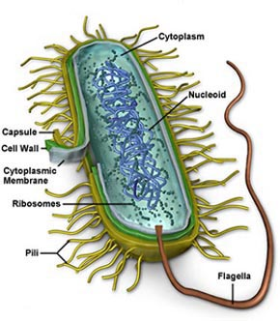
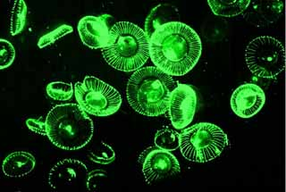
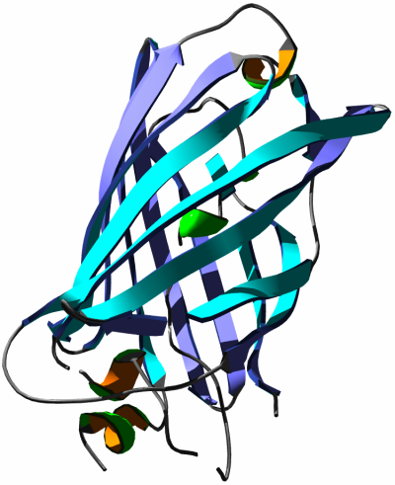
GFP Transformation Lab
Images taken without permission from http://upload.wikimedia.org/wikipedia/de/4/4d/Protein_GFP_1EMA.png, http://bioinfo.biotec.or.th/Picture/Cell%20Tutorial/image005.jpg, http://www.plantsci.cam.ac.uk/Haseloff/SITEGRAPHICS/Jellyfish.jpeg

Slide 3
Bring Biotechnology to your Classroom
Demonstrate the central framework of molecular biology
Transform bacteria into glowing colonies
Select for transformed Cells by antibiotic resistance
View operon control over pGLO protein production
Introduction to Biomanufacturing

Slide 4
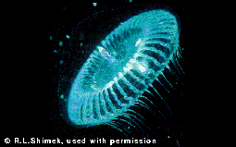
GFP (Green Fluorescent Protein)‏
Naturally produced in Jellyfish– Aequorea victoria
Discovered in 1960’s
Source of bioluminescence when exposed to UV light
Img Src: http://icbxs.ethz.ch/members/leu/jellyfish.gif , http://www.plantsci.cam.ac.uk/Haseloff/SITEGRAPHICS/Jellyfish.jpeg

Slide 5
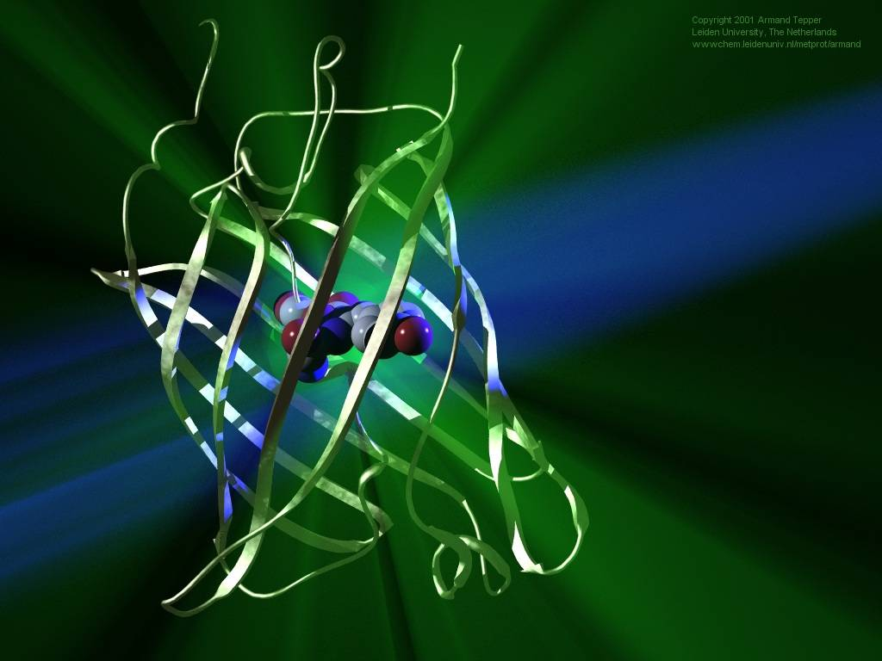
Structure of the GFP Protein
Img Src: http://wwwchem.leidenuniv.nl/metprot/armand/images/029l.jpg

Slide 6
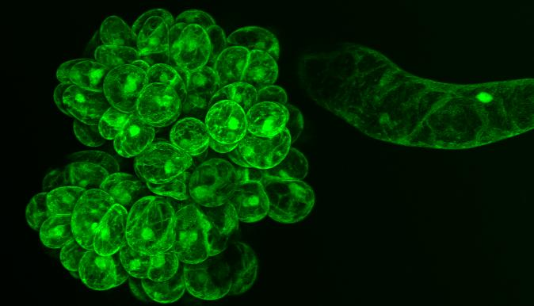
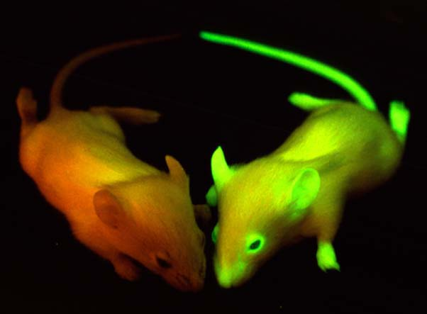
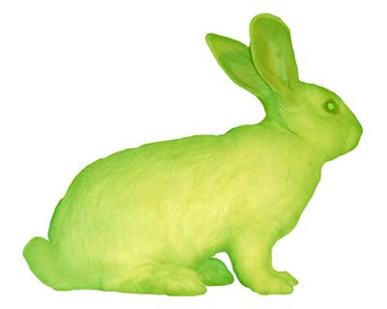
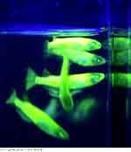
Detecting Gene Activity
PGLO gene is inserted into DNA near a gene of interest
It acts as a reporter gene
- linked to another gene &
glowing protein appears if
it is expressed
Expressed in entire animals
Img Src: http://www.bio.umass.edu/microscopy/images/gfp.jpg
Img Src: http://www.mshri.on.ca/nagy/graphics/GFP%20mice.jpg
Img Src: http://www.antville.org/img/pop/gfp.jpg
Img Src: http://www.computerra.ru/pubimages/73944.jpg
Notes:
Top right– cells that have been tagged with GFP; allows researchers to distinguish certain cells
Bottom right- transgenic mice; mouse embryos were injected with GFP gene then implanted into a surrogate mouse. When born, the mice should express the GFP gene. The lab that works with these mice is trying to use these mice to help them study human disease
Bottom left- Alba the GFP bunny; partnership with an artist and a French lab. Supposed to be part of living art exhibit but lab decided at the last minute to keep the bunny in the lab.

Slide 7
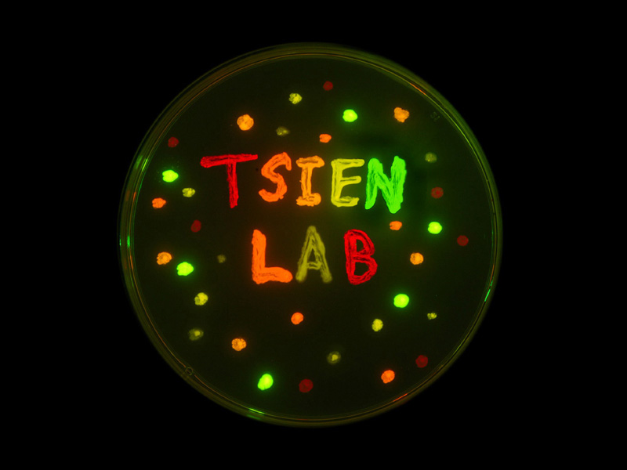
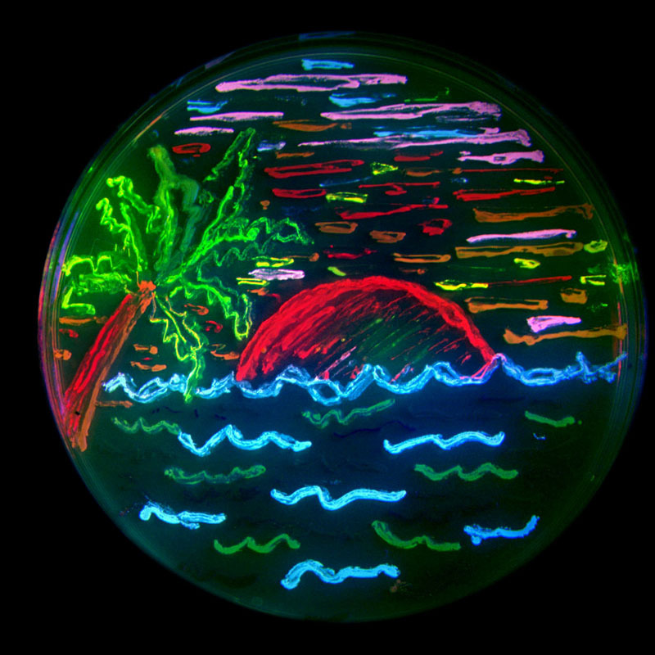
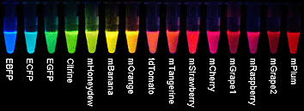
Other Fluorescent Proteins

Slide 8
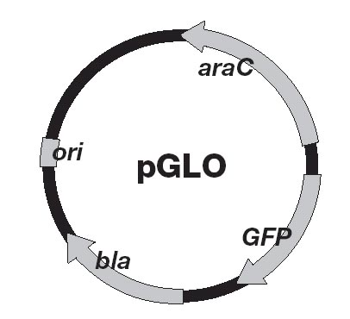
pGLO plasmid
3 genes of interest:
GFP gene
Codes for the GFP protein
Bla gene
Codes for the enzyme β-lactamase
β-lactamase destroys the antibiotic ampicillin
araC regulator protein
Controls expression of GFP
Notes:
Ori = origin of replication. Students don’t have to worry about this.

Slide 9
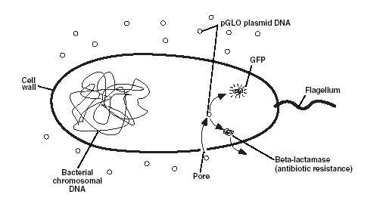
Overall Goal of Lab Experiment
Use genetic engineering techniques to insert the GFP gene into E. coli
Plasmid containing gene of interest
Protein to be produced

Slide 10
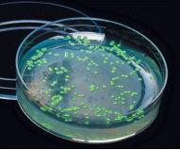
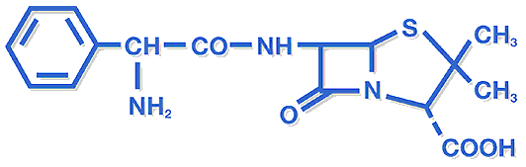
Selecting for Transformed Cells
Selectable Marker: Trait that helps identify a transformed cell by conferring resistance to ampicillin
Ampicillin presence in LBAgar will kill wild type E.coli BUT
Transformed E. coli survive in the presence of ampicillin in LB Agar
Transformed E.coli
ampicillin
Images taken without permission from http://www.antibioresistance.be/Gifs_Ant/blue2.gif and http://www.antibioticos.it/images/formule%20chimiche/ampicillin.gif

Slide 11
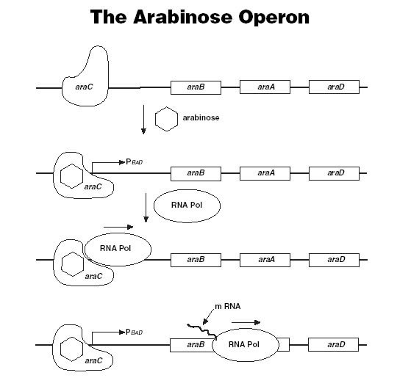
Arabinose Operon
The arabinose operon in bacteria consists of the following:
Usually, the araC protein binds to the arabinose operon operator → prevents transcription
When arabinose is present, it binds to the araC protein -> can’t bind to operator → RNA polymerase can continue

Slide 12
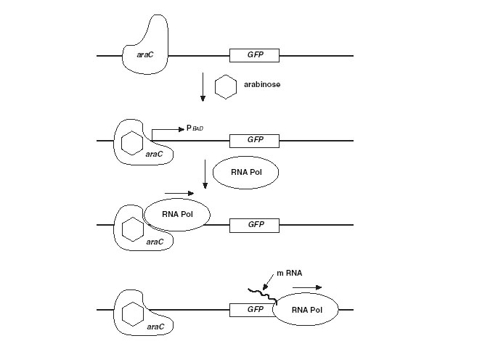
Scientists modified the arabinose operon in pGLO to express the GFP gene.
araC protein binds to the operator → prevents transcription
When arabinose binds to araC it can no longer bind to operator → GFP gene is transcribed and translated

Slide 13
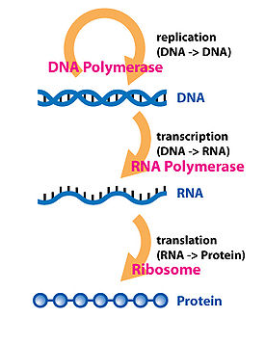
Central Dogma of Molecular Biology

Slide 14
Controls
Spread E. coli without plasmid (- DNA) on plain LB agar
Wild type E. coli can grow demonstrated
Spread E. coli without plasmid (- DNA) on LB/amp
E. coli aren’t already resistant to ampicillin

Slide 15
Transformation Yields Product
What does this lead to?
Ability to produce a protein we need but can't make
Cell acts as the factory for the product under the correct conditions
Increased cell number yields increased product

Slide 16
Transformation Procedure
Step 1 Prepare appropriate plates
Step 2 Suspend cells in CaCl2 solution
Step 3 Add pGLO plasmid to cells/put onto ice
Step 4 Heat Shock at 42oC /put onto ice
Step 5 Add nutrient broth to cells
Step 6 Streak cells on to appropriate plates

Slide 17
Transformation Time Line
First step: Grow up colonies of E.coli
Second step: Prepare Selective media
Transform cells with pGLO plasmid
Detect transformed cells
2-3 days required
1 day
45 minutes
Results in 24 hours
Supplies for up to 32 students

Slide 18
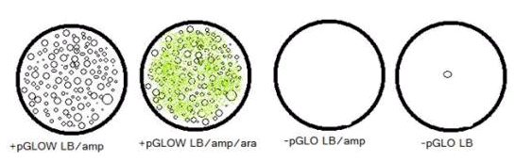
PGLO Transformed E.coli
Cells containing pGLO plasmid are now resistant to ampicillin
Cells containing pGLO plasmid will also glow green when arabinose

Slide 19
Biomanufacturing
Upstream Processing: Growing genetically transformed cells that produce a desired protein
Downstream Processing: Separation and purification of that product for human use

